Slide 1
Writing for Impact
March 2017. Kindly contributed by Suz Groves, Lowestoft College.
Search for Suz on www.skillsworkshop.org and visit the download page for this resource to find related PDF and Word files and curriculum links.
GCSE English Writing
AO5 Communicate clearly, effectively and imaginatively, selecting and adapting tone, style and register for different forms, purposes and audiences
Organise information and ideas, using structural and grammatical features to support coherence and cohesion of texts
AO6 Candidates must use a range of vocabulary and sentence structures for clarity, purpose and effect, with accurate spelling and punctuation
Functional English Writing
Functional English does not assess descriptive (fiction) writing. However, planning and drafting, audience and purpose, and the consideration of language devices covered in this resource (& the accompanying PDF) are all relevant to Functional Skills.
L2: Present information/ideas concisely, logically, and persuasively
Use a range of writing styles for different purposes
Punctuate written text using commas, apostrophes and inverted commas accurately
Ensure written work is fit for purpose and audience, with accurate spelling and grammar that supports clear meaning
Notes:
March 2017. Kindly contributed to www.skillsworkshop.org by Suz Groves, Lowestoft College.

Slide 2
Writing for Impact Component 1: Fiction and Imaginative Writing
Suz Groves
Welcome to this session!
Notes:
March 2017. Kindly contributed to www.skillsworkshop.org by Suz Groves, Lowestoft College.

Slide 3
LESSON AIM
At the end of this session, you will have produced
a piece of descriptive writing using an image
Objectives
Understand how to quickly plan a piece of writing.
To consider audience, purpose, tone and language
devices in your writing.
Answer questions to create a character profile.
Create a draft of descriptive writing in your group
and mark it out of 5.
Notes:
March 2017. Kindly contributed to www.skillsworkshop.org by Suz Groves, Lowestoft College.

Slide 4
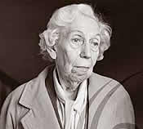
Today we are writing to inform, explain and describe using an image.
Notes:
March 2017. Kindly contributed to www.skillsworkshop.org by Suz Groves, Lowestoft College.

Slide 5
Here’s one we prepared earlier…
Here is an example of a descriptive text about the Lady....
Note the use of different language techniques
The tone/genre of the writing
And the content – does it describe?
Which bits of the text stand out?
Does it make you want to read more?
Who would the audience be?
Notes:
March 2017. Kindly contributed to www.skillsworkshop.org by Suz Groves, Lowestoft College.

Slide 6
The Lady
She was a feisty old girl, that Eve, who most describe as old in looks but definitely not in mind. She used to write children's novels, though that has stopped. Her house is grey, grim and gothic, and is prowled through by her cat, Gabriel. He mainly keeps to the deep, deep shadows in the miles of empty passageways. The only person who’s allowed to stroke Gabriel's soft, fluffy fur is the old woman. They have a peculiar, solitary relationship.
Eve lives with her deceased husband in her giant mansion on the teetering edge of the city of Durham. Her great house looks out over mangled, tangled dark woods that haven’t welcomed a living soul for many years – if ever!
Every morning she hears the birds twittering in the trees in her large, untidy garden full of secret smells from the hundreds of plants and flowers she cultivates.
Eve often sits in her conservatory and gazes out of the window thinking of new stories, wishing she could start writing again....
Notes:
March 2017. Kindly contributed to www.skillsworkshop.org by Suz Groves, Lowestoft College.

Slide 7
For today’s task you will need to consider:
Genre, Tone and mood
(eg formal, informal, tension, disaster, surprise)
Purpose
To describe, inform and explain
Audience
People interested in reading fiction
Writing techniques
(rule of three, repetition, simile, alliteration)
Notes:
March 2017. Kindly contributed to www.skillsworkshop.org by Suz Groves, Lowestoft College.

Slide 8
A Forest Refers to the use of the following techniques in a text
Features of writing – in A FOREST
A – Alliteration, Assonance
F – Facts, formal (informal)
O – Opinion, Onomatopoeia
R – Repetition/ Rhetorical Questions
E – Emotive Language
S – Statistics, Simile
T – Triples (rules of three), Tone
Notes:
March 2017. Kindly contributed to www.skillsworkshop.org by Suz Groves, Lowestoft College.

Slide 9
Descriptive Writing Assessment Piece– to get a good grade GCSE 9-1
Write in an appropriate manner for the genre or purpose of your story.
Use a varied range of sentences and vocabulary to keep your audience’s interest.
Keep punctuation accurate and produce logical paragraphs to make your meaning clear.
Develop characters and settings within your narrative.
Use literary devices such as rhetorical questions and metaphors effectively.
Show an awareness of tone in words and sentences.
Write with flair and originality.
Notes:
March 2017. Kindly contributed to www.skillsworkshop.org by Suz Groves, Lowestoft College.

Slide 10
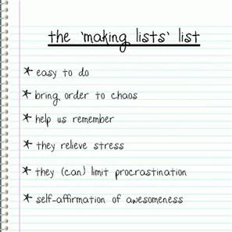
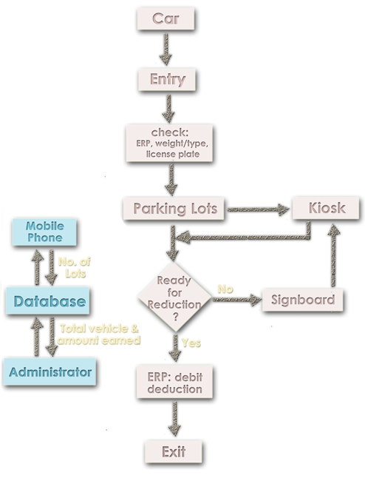
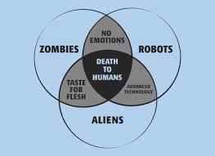
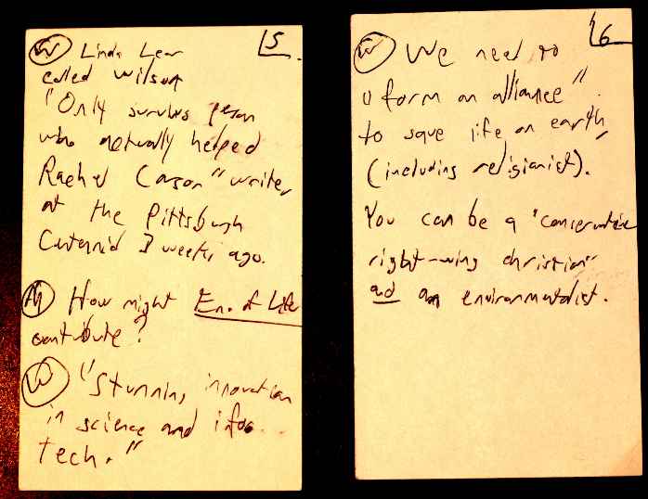
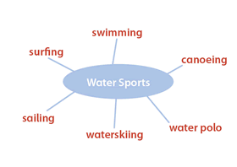
We need a plan!
You can put together a quick plan for your writing by making notes or lists, a flow chart or doing a spider gram to map your ideas.
Writing to describe
Notes:
March 2017. Kindly contributed to www.skillsworkshop.org by Suz Groves, Lowestoft College.

Slide 11
Now its your turn!
How does this
woman feel?
Why does she
feel this way?
Where has she
come from?
Notes:
March 2017. Kindly contributed to www.skillsworkshop.org by Suz Groves, Lowestoft College.

Slide 12
Make a plan!
Look at the picture of the Lady you have been given and in your groups choose a method of planning your writing.
Answer the questions on your hand-out. You have 3 or 4 minutes to complete your plan.
Notes:
March 2017. Kindly contributed to www.skillsworkshop.org by Suz Groves, Lowestoft College.

Slide 13
Give this lady a character profile and make some notes to help plan your writing.
Think about these questions:
1. Who is this lady?
2. Where does she live?
In the countryside, in the city? Where?
3. What kind of house does she live in?
Is it big, small, old, modern, warm, comfortable, cold?
4. How old is she?
Is she fairly young, old, very old?
5. Has she got any family?
Does she have a husband? Any children? Any grandchildren? Does anyone live with her?
6. Has she got any pets?
7. What does she do all day?
Does she have a job, have any hobbies?
8. What is she thinking about?
Is she happy, sad? Why?
Notes:
March 2017. Kindly contributed to www.skillsworkshop.org by Suz Groves, Lowestoft College.

Slide 14
Activity
In your groups
Using the answers you have given in your plan, write a description of the Lady, in paragraph form.
You have 5 minutes to produce a draft

Slide 15
Review
After writing your story, take a look at it and consider the following…..
Notes:
March 2017. Kindly contributed to www.skillsworkshop.org by Suz Groves, Lowestoft College.

Slide 16
How well have you met the criteria? Does it. . .
Describe, explain and inform?
Suit your desired audience?
Set an appropriate tone/ genre?
Describe effectively using at least one literary device?
Make you want to read more?
GIVE YOURSELF
A MARK OUT OF
FIVE!
Notes:
March 2017. Kindly contributed to www.skillsworkshop.org by Suz Groves, Lowestoft College.

Slide 17
Have we met the aim and objectives?
Have you produced a plan and a draft?
Understood how to quickly plan a piece of writing?
Considered audience, purpose, tone and literary
devices in your writing?
Answered questions to plan a character profile?
Created a draft of descriptive writing in your group
and marked it out of 5?
Notes:
March 2017. Kindly contributed to www.skillsworkshop.org by Suz Groves, Lowestoft College.

Slide 18
GCSE 9-1
Assessment Objectives and weightings
WRITING
AO5 ● Communicate clearly, effectively and imaginatively,
selecting and adapting tone, style and register for
different forms, purposes and audiences
● Organise information and ideas, using structural and
grammatical features to support coherence and
cohesion of texts
30% of marks in GCSE
AO6 Candidates must use a range of vocabulary and
sentence structures for clarity, purpose and effect, with
accurate spelling and punctuation
20% of marks in GCSE
Notes:
March 2017. Kindly contributed to www.skillsworkshop.org by Suz Groves, Lowestoft College.

