Slide 1
L1-2 Functional Skills English Benefits of the staycation: reading, writing & discussion
July 2021. Kindly contributed by Stephanie Gilford, Birmingham Adult Education Service.
Search for Stephanie on www.skillsworkshop.org
Please refer to the download page for this resource on skillsworkshop for detailed curriculum links and related resources. https://www.skillsworkshop.org/resources/english_the_benefits_of_the_staycation
For full use of hyperlinks and other features, this presentation should be run in full screen mode.
Covers many Reformed Functional Skills English content descriptors, including:
Speaking, listening and communication: L1.4 Communicate information, ideas and opinions clearly and accurately on a range of topics L1.5 Express opinions and arguments and support them with evidence L2.5 Communicate information, ideas and opinions clearly and effectively, providing further detail and development if required | Reading: L1.12 Recognise that language and other textual features can be varied to suit different audiences and purposes L1.13 Use reference materials and appropriate strategies (e.g. using knowledge of different word types) for a range of purposes, including to find the meaning of words L1.17 Read and understand a range of specialist words in context L1.18 Use knowledge of punctuation to aid understanding of straightforward texts. L2.15 Use a range of reference materials and appropriate resources (e.g. glossaries, legends/keys) for different purposes, including to find the meanings of words in straightforward and complex sources | Writing: L1.22 [L2.23] Communicate information, ideas and opinions clearly, coherently and accurately L1.24 Use format, structure and language appropriate for audience and purpose L2.27 Use different language and register (e.g. persuasive techniques, supporting evidence, specialist words), suited to audience and purpose
Notes:
July 2021. Kindly contributed to www.skillsworkshop.org by Stephanie Gilford, Birmingham Adult Education Service.
1

Slide 2
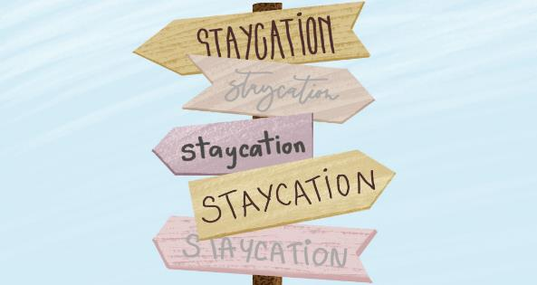
The Staycation
Language features
Can you identify any language features in the text. Give examples for those that you spot.
Challenge!
Why does ‘far-flung’ contain a hyphen?
Key Vocabulary | Definition
Craving
Wanderlust
Punctuation practice!
Why has the writer used brackets in this sentence? ‘…far-flung destinations might not be possible (or safe) at the moment.’
What are our options for Summer ‘21?
Having been homebound for quite a while now, many globetrotters from around the world are craving some well-deserved travel time to relax and recharge. But due to current restrictions, uncovering far-flung destinations might not be possible (or safe) at the moment. So, instead of hopping on an airplane and heading to the other side of the globe, why not keep your wanderlust alive by rediscovering the beauty in your own city? After all, just because you can’t travel far does not mean you can’t travel at all!
Discussion points…
Before we read ahead, discuss the possible benefits of a staycation in your small groups.
What would you have to consider when planning a Staycation now?
Make a list of all the things you would need to know before planning a break in the city you live in.
What about you?
What do you like to do on Holiday? Could you do any of these activities in your city?
Text source: https://www.cuddlynest.com/blog/what-is-staycation/
Notes:
July 2021. Kindly contributed to www.skillsworkshop.org by Stephanie Gilford, Birmingham Adult Education Service.

Slide 3
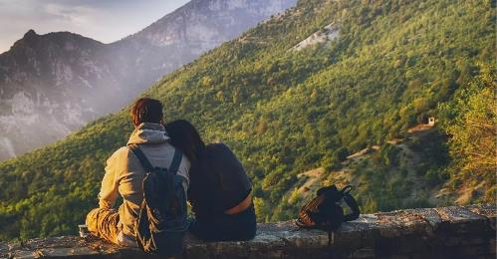
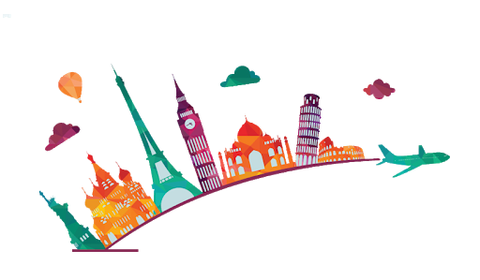
1. Cost!
By taking a staycation, you can skip the heavy costs that come with international travel, including booking flights, accommodation for long periods of time, transportation, and surprisingly expensive meals at a city you don’t know very well. And since staycations are more cost-effective, you can use that saved money to indulge in fun amenities and activities. No to mention that staycations usually have a shorter length, which also means…more money saved!
Punctuation practice!
Which punctuation marks can you spot in the text? Can you identify a variety of different sentence types?
Discussion point…
Using the internet to help you, write a list of all the things your city has to offer and what you could do on a staycation.
2. Reduced travel time…
Reduced travel time allows for more relaxing, adventuring, and fulfilling moments during your trip, whether it’s treating yourself by going to a nearby spa or hiking at your country’s stunning national park. Traveling internationally also requires a lot of planning and organization beforehand. You have to budget your expenses, learn about the destination’s culture, look for accommodation, research convenient flights, pack accordingly for a long trip … the list could go on and on.
Key Vocabulary | Definition
Amenities
Convenient
Accordingly
Can you find any synonyms to replace these words in a sentence?
Text source: https://www.cuddlynest.com/blog/what-is-staycation/
Notes:
July 2021. Kindly contributed to www.skillsworkshop.org by Stephanie Gilford, Birmingham Adult Education Service.

Slide 4
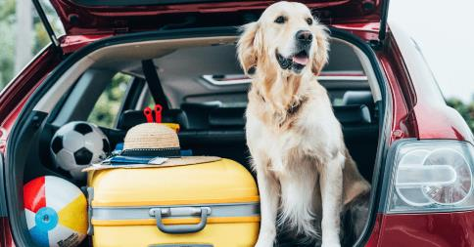
3. Pets!
Although many hotels and vacation rentals strive to be more inclusive towards pet visits, when you opt for staycations, that is one thing less to worry about. You can rest easy and comfortable knowing that whatever experience you embark on, your pet can come along with you. Did you know there are certain countries that even boast and encourage pet-friendly travel? If you live in the US, Germany, or Japan, for instance, then you’re in the perfect spot to staycation with your dog or cat.
Shocking stats…
Expedia saw a 75% increase in interest for UK summer holidays “in hotspots such as Devon, Cornwall, Hampshire, the Lake District and Bournemouth” in January.
4. Supporting the local Economy…
Is there a new restaurant in your city that you have been craving to go to? Or a new eco-friendly boutique hotel within a driving distance from your home? If so, a staycation is a perfect opportunity to support the local economy by uncovering nearby tourist attractions. During your “stay-at-home holidays”, you visit local food markets, try out trendy new cafes, and even book a nearby comfy accommodation, which will certainly boost your city’s revenue and sustainable travel efforts.
Language features
Can you identify any language features in the text. Give examples for those that you spot.
Key Vocabulary | Definition
Strive
Embark
Trendy
Revenue
Sustainable
Discussion point…
Why do we tend to go abroad on holidays rather than staying in the UK? Why are more people staying in the UK in 2021?
Text source: https://www.cuddlynest.com/blog/what-is-staycation/
Notes:
July 2021. Kindly contributed to www.skillsworkshop.org by Stephanie Gilford, Birmingham Adult Education Service.

Slide 5
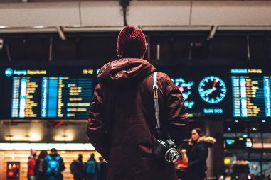
5. Quality time with family and friends
Whether you’re going on a road trip with your kids, camping with friends, or spending a romantic weekend at a boutique hotel, a staycation is a great way of reconnecting with your loved ones. Because you spend less time stressing about flights, planning, car rentals, and currency transfers, you can focus more on having quality time with the special people in your life.
Adjective spotting…
Can you identify any adjectives on this slide? What are they? Can you use them in a sentence of your own to describe the city you live in?
Punctuation practice!
Which punctuation marks can you spot in the text? Can you identify a variety of different sentence types?
Punctuation practice!
How does the writer use commas in the following sentence? ‘Because you spend less time stressing about flights, planning, car rentals, and currency transfers’.
Key Vocabulary | Definition
Currency
Discussion point…
Who would you want to spend your Staycation with?
6. You Can Staycation From Anywhere In The World
Whether you’re originally from Rome and have never visited Florence, or from Hawaii and have never been to Waikiki Beach, your very own country can offer you a delightful maze of experiences worth living. And you don’t even have to go far away and fly across your country during your staycation! Travellers can very much ditch the airport and spend a relaxing week exploring their own city.
Mini writing task…
How could you use language features to persuade others in your city to stay at home for their holiday this year? Write a short paragraph.
Text source: https://www.cuddlynest.com/blog/what-is-staycation/
Notes:
July 2021. Kindly contributed to www.skillsworkshop.org by Stephanie Gilford, Birmingham Adult Education Service.

Slide 6
Writing task…
Imagine that to improve the mental health of the people living in the UK, the government is giving a small grant to each household to spend on a weekend staycation to encourage local exploration, boost the economy, and bring some joy to families after the pandemic. Each household will have £250 as a starting point. If there is more than three people in the household, they will receive an additional £30 per person that they have. For example: If there are five people in your household you will receive £250 plus £30 X 2. In total, you will receive £310 to spend on your Staycation. You should write a formal letter of application to your local council, confirming your plans so that they can distribute the funds as promised.
What are you going to do?
In your writing task, you should: Explain where you will stay in your city. Identify an activity for each day for you and your family. You should also explain why the activities are a good choice. Identify food sources.
Vocabulary variety…
Make a short list of five key words you will use in your letter to refer to your Staycation plans. You can use the words that we have discovered while reading about Staycations.
Key Vocabulary I will use… | Definition
Word | Definition
Plan your holiday before you start writing…
Please make sure that you plan your writing before you begin. This will help to make your writing more concise.
Notes:
July 2021. Kindly contributed to www.skillsworkshop.org by Stephanie Gilford, Birmingham Adult Education Service.

