Slide 1
L1-2 Functional Skills English Squid Game and on-screen violence Reading, research & discussion skills
December 2021. Kindly contributed by Stephanie Gilford, Birmingham Adult Education Service.
Search for Stephanie on www.skillsworkshop.org
Please refer to the download page for this resource on skillsworkshop for detailed curriculum links and related resources.
https://www.skillsworkshop.org/resources/english_squid_game_and_onscreen_violence
For full use of hyperlinks, videos and other features, this presentation should be run in full screen mode.
Covers many Reformed Functional Skills English content descriptors, including:
Speaking, listening and communication: L1.4 Communicate information, opinions & ideas clearly & accurately on a range of topics L1.5 Express opinions and arguments and support them with evidence L2.5 Communicate information, ideas and opinions clearly and effectively, providing further detail and development if required L2.6 Express opinions and arguments and support them with relevant and persuasive evidence | Reading: L1.11 Identify meanings in texts and distinguish between fact and opinion L1.12 Recognise that language and other textual features can be varied to suit different audiences and purposes L1.13 Use reference materials and appropriate strategies (e.g. using knowledge of different word types) for a range of purposes, including to find the meaning of words L1.15 Infer from images meanings not explicit in the accompanying text L1.17 Read and understand a range of specialist words in context L1.18 Use knowledge of punctuation to aid understanding of straightforward texts. L2.14 Understand the relationship between textual features and devices, and how they can be used to shape meaning for different audiences and purposes
Subject content [reformed] functional skills: English (DfE, Feb 2018): https://www.gov.uk/government/publications/functional-skills-subject-content-english
Notes:
December 2021. Kindly contributed to www.skillsworkshop.org by Stephanie Gilford, Birmingham Adult Education Service.
1

Slide 2
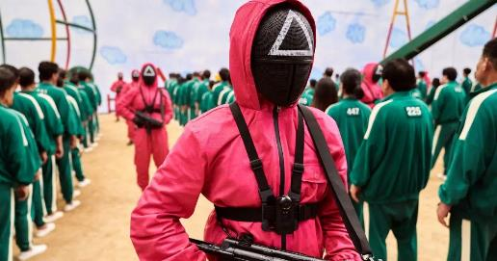
Squid Game
A rising star…
The Korean thriller, which tells the story of debt-ridden people competing for a huge cash prize in a deadly series of children's games, has become Netflix's biggest ever series launch - streamed by 111 million users in its first 28 days.
Key Vocabulary | Definition
Debt-ridden
Incorporate
Mysterious
What is Squid Game?
A story of people who fail at life for various reasons, but suddenly receive a mysterious invitation to participate in a survival game to win more than 38 million US dollars. The game takes place at an unknown location and the participants are locked up until there is a final winner. The story will incorporate popular children's games from the 1970s and 1980s of Korea.
Why has the writer chosen to use this phrase ‘fail at life’? How can we fail at life?
Discussion questions…
1. To what extent do you think money controls our lives? You must be able to explain your answer.
2. What gives our lives meaning and allows us to progress?
Punctuation practice: why does the phrase ‘debt-ridden’ include a hyphen?
3. What is capitalism? Is capitalism good? Why/why not? Please give evidence to support your explanations.
Make a prediction: what do you think happens to those who lose the game? Why do you think this?
If you have already seen the series, were you surprised by the outcome?
4. Squid Game is a children’s game from Korea – what did it entail?
Notes:
December 2021. Kindly contributed to www.skillsworkshop.org by Stephanie Gilford, Birmingham Adult Education Service.

Slide 3
What if winning playground games could make you rich? That’s the basis of Squid Game – the South Korean show currently at number one on Netflix around the world – where debt-ridden players sign up to compete in six games for a cash prize of 45.6 billion won (around £28m). The small print: if you lose, you get killed. In the first episode, a game of Grandma’s Footsteps (known as Red Light, Green Light in South Korea) leaves bodies piled high as the shell-shocked winners proceed to round two. It’s blood-splattered child’s play – a kind of Takeshi’s Castle with fatalities or Saw with stylish shell suits.
Can you identify any language features in this paragraph and highlight examples?
If you have watched Squid Game, why did you watch it? What drew you to the programme?
Can you identify any facts in this paragraph? How do we know that they are facts?
If you haven’t watched Squid Game, why not? Is there something putting you off?
Punctuation practice…
How many different types of punctuation marks can you identify in the paragraph above? Can you write a short review of Squid Game, or another TV series that you like, using as many of these punctuation marks as possible?
Watch the video:
How does this make you feel about Squid Game?
Notes:
December 2021. Kindly contributed to www.skillsworkshop.org by Stephanie Gilford, Birmingham Adult Education Service.

Slide 4
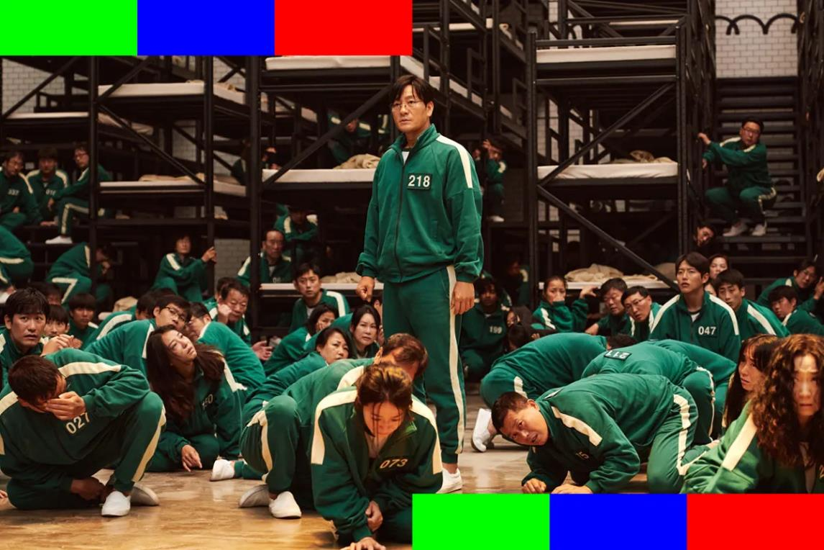
Inference…
What can you infer from this image? Who is in power? What clues did you use to help you infer information?
Hidden meanings #1…
Why do you think those participating in the games are all dressed in green? What can the color green mean? Why are they all dressed the same?
Stretch and challenge…
What are the connotations of the colour pink? Why are the guards dressed in this colour? Do the jumpsuits look casual, or formal? Why is this?
Hidden meanings #2…
Why do you think all of the participants have been given numbers? In what other situations are we assigned numbers?
Notes:
December 2021. Kindly contributed to www.skillsworkshop.org by Stephanie Gilford, Birmingham Adult Education Service.

Slide 5
Hidden meanings #3…
Have you seen these symbols before? If so, where?
What do you think?
Is it significant that these symbols on the guards’ helmets mirror the symbols on a PlayStation controller?
Notes:
December 2021. Kindly contributed to www.skillsworkshop.org by Stephanie Gilford, Birmingham Adult Education Service.

Slide 6
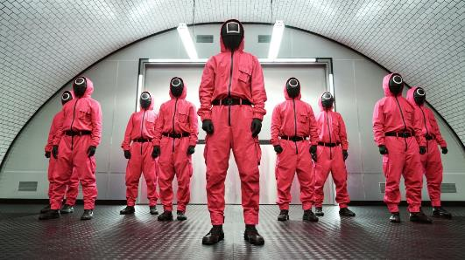
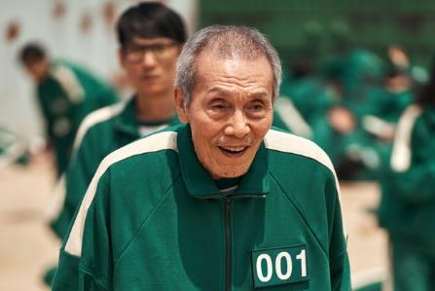
Why do we, as a society, like watching series/films with violence in? Make a list.
How do you feel when watching scenes of violence? Has violence become normal to us?
Should we stick to the suggested viewing age-limits on series and films? Why/why not?
Predictions, Predictions, Predictions…
What do you think the three biggest problems with Squid Game are? What have you heard about it?
Does watching scenes of violence make us more likely to be violent ourselves?
Notes:
December 2021. Kindly contributed to www.skillsworkshop.org by Stephanie Gilford, Birmingham Adult Education Service.

Slide 7
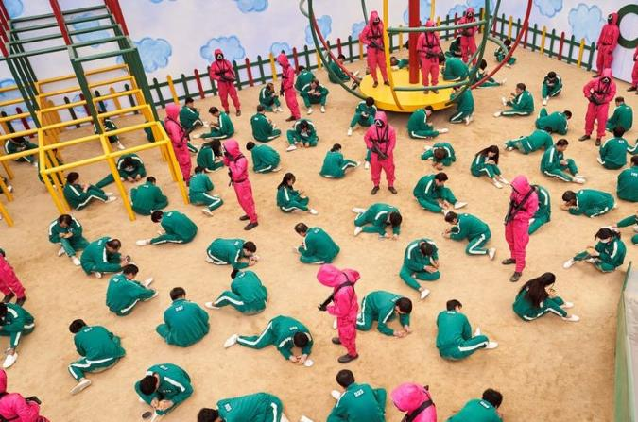
Key Vocabulary | Definition
Violent thriller
Parental locks
Masked
Solutions?
Teachers are calling for parents to put parental locks on devices to stop their children from watching the show.
Does violence breed violence?
Pupils as young as six have been acting out games from violent Netflix thriller Squid Game, teachers have warned.
What are the possible other causes of violence in the real world?
What would happen if we stopped making violent shows and films?
Watch the 60 second video: what do you think? Does violence make us more violent?
Does violence breed violence?
Now, the South Korean show that sees hundreds of debt-ridden people compete for a cash prize in a series of survival tasks masked as playground games has come under fire among school teachers who have concerns that children are replicating some of the challenges.
What does the phrase ‘under fire’ mean? Why has the writer chosen to use it here?
Notes:
December 2021. Kindly contributed to www.skillsworkshop.org by Stephanie Gilford, Birmingham Adult Education Service.

Slide 8
Primary schools in the US, Australia, Asia, and Europe have all issued warnings to parents about the Netflix series, asking parents to make sure their kids don’t watch Squid Game. The South Korean show depicts “extreme violence and gore,” following adults riddled with debt playing scary life-or-death versions of popular playground games. It’s an interesting show for adults and has some meanings behind it other than shock factor violence, but that’s not a nuance most kids will pick up on.
The United Kingdom…
“Also please explicitly share that pretending to shoot one another is not appropriate - nor acceptable. Please support us in keeping your children safe.” Meanwhile, another school in Kent, Sandown, has started offering extra lessons on violence and online harm in response to the programme’s popularity.
Is Squid Game a problem? Why/why not?
“Violent language and aggressive behaviours may be easily mimicked by children, particularly outside the confines of your home and in the wider space of a school playground,” Wickham said.
Do you agree? Why/why not?
A school in Belgium sent a warning to parents on social media, too. The notification said students were found playing Squid Game-style games on the playground where the consequences of losing resulted in getting punched.
Notes:
December 2021. Kindly contributed to www.skillsworkshop.org by Stephanie Gilford, Birmingham Adult Education Service.

Slide 9
Capitalism…
Key Vocabulary | Definition
Production
Distribution
Determined
Essential
Motive
Profit
"It is said that [Squid Game] makes people realize the sad reality of the beastly South Korean society in which human beings are driven into extreme competition and their humanity is being wiped out”.
A definition…
An economic system in which the means of production and distribution are owned and controlled mostly by private individuals and businesses for profit, thus what is produced, and the quantities thereof are determined by consumer demand and competition. The essential feature of capitalism is the motive to make a profit.
What type of word is ‘beastly’? Why is South Korea described as Beastly?
What kinds of people would be those so disadvantaged that they would need to be involved in Squid Game?
Main themes…
Beyond the games themselves, this is a show about poverty, inequality and desperation—and the insidious ways money can turn us against one another. Greed and power make the world go ‘round, but Squid Game shows that even so, good can still triumph over evil. At a cost.
And, according to North Korea, it's also proof that capitalism doesn't work.
How are commas used in these paragraphs? There might be more than one use. Can you write a sentence about an aspect of Squid Games using commas in the same way?
Key Vocabulary | Definition
Insidious
Triumph
How else could we run countries? Are there better systems than capitalism?
Notes:
December 2021. Kindly contributed to www.skillsworkshop.org by Stephanie Gilford, Birmingham Adult Education Service.

Slide 10
"It is the current South Korean society where the number of losers in fierce competitions, such as employment, real estate and stocks, increases dramatically," the North Korean propaganda reads. It adds that Squid Game shows "the reality of living in a world where people are judged only by money.”
North and South Korea have been engaged in a civil war since 1950, though overt military action between the two Koreas ceased in 1953. After 30 years of turmoil and military rule, South Korea became a democracy in 1986 and today has the world's 12th biggest economy. Meanwhile, North Korea has been ruled by three generations of the Kim family. Its GDP is estimated to be just over $27 billion, as compared with South Korea's $1.5 trillion.
"Under the rule of Kim Jong Un, the third leader of the nearly 75-year Kim dynasty, the totalitarian government deepened repression and maintained fearful obedience using threats of execution, imprisonment, enforced disappearance, and forced labor," Human Rights Watch wrote in a 2020 report.
What is a democracy?
What is a totalitarian government? How do the two differ?
Are these discussions around governmental systems important?
Can you identify any language features in this paragraph and highlight examples?
Key Vocabulary | Definition
Propaganda
Civil War
Overt
Dynasty
Repression
Obedience
How else could we run countries? Are there better systems than capitalism? Do some research and find out!
Notes:
December 2021. Kindly contributed to www.skillsworkshop.org by Stephanie Gilford, Birmingham Adult Education Service.

