Slide 1
L1-2 ESOL and Functional Skills English Speedo Mick
February 2023. Kindly contributed by Matt Lunt, The City of Liverpool College.
Search for Matt on www.skillsworkshop.org
Please refer to the download page for this resource on skillsworkshop for detailed curriculum links and two related resources: teacher notes / lesson plan and a worksheet which includes a text, comprehension questions and discussion / role play ideas.
https://www.skillsworkshop.org/resources/speedo_mick
Important: the video part of the lesson is optional. See teacher notes and use your professional judgement.
For full use of hyperlinks and other features, this presentation should be run in full screen mode.
Covers many ESOL and Functional Skills English ICT criteria, including:
ESOL: ESOL Rt/L1.3a Understand how main points and specific detail are presented and linked ESOL Rt/L1.5a Use skimming, scanning and detailed reading in different ways for different purposes ESOL Rt/L2.3a Identify the main points & specific detail in different types of text of varying lengths & detail ESOL Rt/L2.7a Use different reading strategies to find and obtain information, e.g. skimming, scanning, detailed reading ESOL Lr/L1.1a Extract information from texts of varying genre, e.g. radio, TV ESOL Lr/L1.5a Respond to questions on a range of topics ESOL Lr/L2.1a Extract information from extended texts in a non-face-to-face context, e.g. radio ESOL Lr/L2.3a Respond to detailed or extended questions on a range of topics ESOL Sd/L1.2a Express views and opinions ESOL Sd/L1.1c Express likes, dislikes, feelings, hopes, etc. ESOL Sd/L2.2c Express views, opinions, feelings, wishes Adult ESOL Core Curriculum (DfES, 2001) https://www.excellencegateway.org.uk/content/etf1194 Sc = Speak to communicate Sd = Engage in discussion Lr = Listen & respond Rt = Reading (text level) | Functional Skills English ESOL Rt/L1.3a Understand how main points and specific detail are presented and linked ESOL Rt/L1.5a Use skimming, scanning and detailed reading in different ways for different purposes ESOL Rt/L2.3a Identify main points and specific detail in different types of text of varying lengths & detail ESOL Rt/L2.7a Use different reading strategies to find and obtain information, e.g. skimming, scanning, detailed reading ESOL Lr/L1.1a Extract information from texts of varying genre, e.g. radio, TV ESOL Lr/L1.5a Respond to questions on a range of topics ESOL Lr/L2.1a Extract information from extended texts in a non-face-to-face context, e.g. radio ESOL Lr/L2.3a Respond to detailed or extended questions on a range of topics ESOL Sd/L1.2a Express views and opinions ESOL Sd/L1.1c Express likes, dislikes, feelings, hopes, etc. ESOL Sd/L2.2c Express views, opinions, feelings, wishes Subject content [reformed] functional skills: English (DfE, Feb 2018) https://www.gov.uk/government/publications/functional-skills-subject-content-english
Notes:
February 2023. Kindly contributed to www.skillsworkshop.org by Matt Lunt, The City of Liverpool College
1

Slide 2
Speedo Mick
ESOL Level 1/2
Notes:
February 2023. Kindly contributed to www.skillsworkshop.org by Matt Lunt, The City of Liverpool College

Slide 3
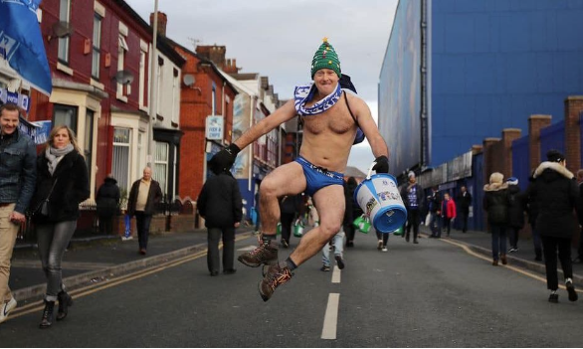
What can you see in this picture?
Notes:
February 2023. Kindly contributed to www.skillsworkshop.org by Matt Lunt, The City of Liverpool College

Slide 4
"Speedo Mick set to start final fundraising walk"
Notes:
February 2023. Kindly contributed to www.skillsworkshop.org by Matt Lunt, The City of Liverpool College

Slide 5
What other activities do people do for fundraising?
Notes:
February 2023. Kindly contributed to www.skillsworkshop.org by Matt Lunt, The City of Liverpool College

Slide 6
What other activities do people do for fundraising?
A sale (clothes, cakes, meals)
A party. A charity 'do'
Writing letters to big companies/organisations
Auctioning/raffleing signed shirts/photos/pictures
Talent show
Marathon
Sponsoring animals
Charity race
Charity football match
Notes:
February 2023. Kindly contributed to www.skillsworkshop.org by Matt Lunt, The City of Liverpool College

Slide 7
https://www.bbc.co.uk/news/uk-england-merseyside-64108745
Notes:
February 2023. Kindly contributed to www.skillsworkshop.org by Matt Lunt, The City of Liverpool College

Slide 8
Video questions
What happened to Mick during the Coronavirus lockdown?
What did he do to help himself?
What important advice does Mick give to people who are suffering?
What is the main reason for his fundraising?
How does Mick manage his own mental health?
Notes:
February 2023. Kindly contributed to www.skillsworkshop.org by Matt Lunt, The City of Liverpool College

Slide 9
Discussion questions
How would you describe Mick as a person?
How would you describe Mick physically?
What kind of things do you think he likes and dislikes?
What and who does he care or worry about?
What do you think he believes in?
In what ways are you and Mick similar and different?
What questions would you like to ask Mick if you had the chance?
Notes:
February 2023. Kindly contributed to www.skillsworkshop.org by Matt Lunt, The City of Liverpool College

Slide 10
Connect with Mick on Social Media!
https://linkin.bio/speedomick
Notes:
February 2023. Kindly contributed to www.skillsworkshop.org by Matt Lunt, The City of Liverpool College

