Slide 1
L1-2 Functional Skills English Social Media: discussion skills, reading and writing
July 2021. Kindly contributed by Nikki Milton, Cambridge Regional College.
Search for Nikki on www.skillsworkshop.org
Please refer to the download page for this resource on skillsworkshop for detailed curriculum links and related resources. https://www.skillsworkshop.org/resources/social_media
For full use of hyperlinks and other features, this presentation should be run in full screen mode.
Covers many Reformed Functional Skills English content descriptors, including:
Speaking, listening and communication: L1.3 Respond effectively to detailed questions L1.4 Communicate information, ideas and opinions clearly and accurately on a range of topics L1.6 Follow and understand discussions and make contributions relevant to the situation and subject L2.2 Follow narratives and lines of argument L2.5 Communicate information, ideas and opinions clearly and effectively, providing further detail and development if required L2.6 Express opinions and arguments and support them with relevant and persuasive evidence | Reading: L1.9 Identify & understand the main points, ideas & details L1.12 Recognise that language and other textual features can be varied to suit different audiences and purposes L1.17 Read and understand a range of specialist words in context L2.11 Identify the different situations when the main points are sufficient & when it is important to have specific details L2.14 Understand the relationship between textual features and devices, and how they can be used to shape meaning for different audiences and purposes | Writing: L1.22 Communicate information, ideas and opinions clearly, coherently and accurately FE L1.23 Write text of an appropriate level of detail and of appropriate length to meet the needs of purpose / audience FE L2.27 Use different language and register (e.g. persuasive techniques, supporting evidence, specialist words), suited to audience and purpose L2.23 Communicate information, ideas and opinions clearly, coherently and effectively FE L2.24 Write text of an appropriate level of detail and of appropriate length to meet the needs of purpose and audience
Notes:
July 2021. Kindly contributed to www.skillsworkshop.org by Nikki Milton, Cambridge Regional College.
1

Slide 2
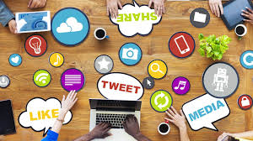
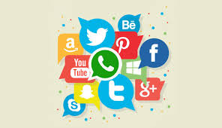
Social Media
How does social media affect stress?
Key Vocabulary
social networking sites
multimedia
digital journalist
adolescence
Mental well-being
BBC Future’s social media producer Sophia Smith Galer monitored her stress levels and social media usage for a week – here’s what she found out.
I wouldn’t describe myself as a particularly stressed-out person. I enjoy my job, have a fairly 9-5 working life and spend the rest of my waking hours doing my best to go out and have fun. I’m a social media producer, meaning that I run accounts on social networking sites and produce multimedia content for them. I’m online all the time, yes, but I’ve never seen that as unusual or stressful; it goes hand-in-hand with being a digital journalist and it seems like a natural progression for somebody who spent much of her adolescence online.
In the pursuit of knowledge, I allowed myself to be a human guinea pig for one week, revealing my stress levels and social media usage to my team and, now, to you. I also managed to persuade other social media producers to get involved to get a broader idea of our relationships with our phones, both within and outside our working life. Importantly, it showed me how I compare to other people – and that’s probably what shocked me the most.
That’s how I used to describe myself until I spent a week testing my stress levels and found out that they’re actually quite high. I’ve spent the last month leading #LikeMinded, BBC Future’s month-long season on social media and its impact on our mental well-being, and it’s made me question my relationship with my smartphone. Turning it on in the morning and staying wired is as integral to my life as clothes and food. Is that habit somehow linked to why I seem to be so stressed?
#LikeMinded
Discussion Point
How would you describe your relationship with your phone?
What advice would you give to a friend who is struggling with high stress levels?
Text Source: https://www.bbc.com/future/article/20180201-what-i-learned-by-testing-my-stress-levels-on-social-media
Notes:
July 2021. Kindly contributed to www.skillsworkshop.org by Nikki Milton, Cambridge Regional College.

Slide 3
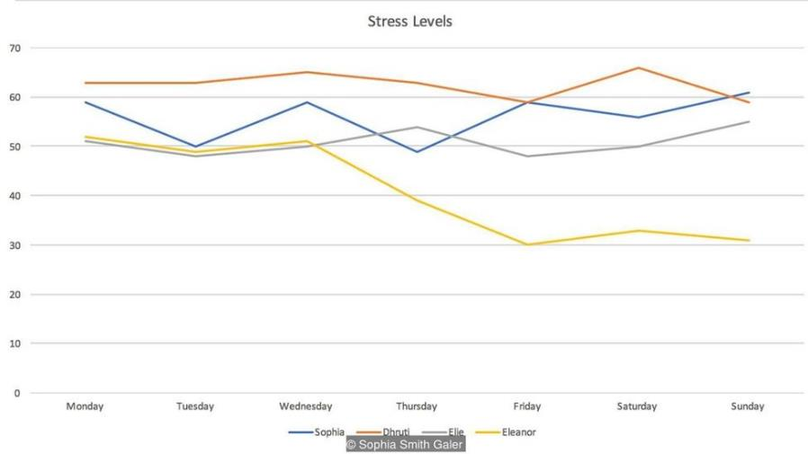
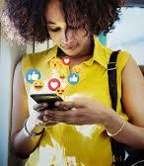
#LikeMinded
Social Media
I used three different monitors to probe my mental well-being and social media use over the week; a Pip, Moment and Checky. The Pip is a little device that measures your stress levels via your fingertips, something that’s known as your electradermal activity. Moment is an app that measures how much time you spend on your phone, and Checky keeps an eye on how many times you check your phone every day. Here are the results from my Pip, alongside those of three other producers: Dhruti Shah from BBC News, Eleanor Dunn from BBC Entertainment News and Elie Gordon who manages social media for BBC Earth.
Discussion Point
What does the line graph tell us about stress Eleanor’s stress levels during the week?
Who has the highest stress levels throughout the week?
Which day do the stress levels appear to be the lowest?
What is the average level of stress on Wednesday?
I learnt three main lessons:
There is no weekend effect
I check my phone a LOT
I go on my phone for escapism
Key Vocabulary
electradermal activity
Pip
Moment
Checky
Line graph
Average (mean)
Text Source: https://www.bbc.com/future/article/20180201-what-i-learned-by-testing-my-stress-levels-on-social-media
Notes:
July 2021. Kindly contributed to www.skillsworkshop.org by Nikki Milton, Cambridge Regional College.

Slide 4
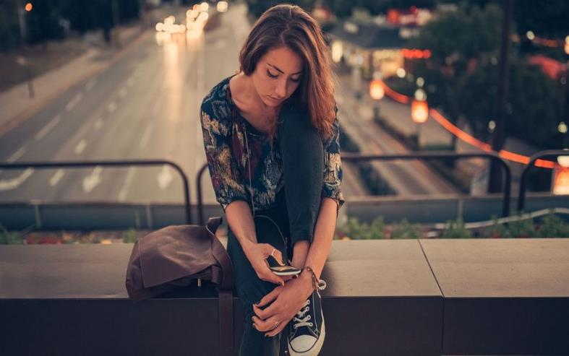
#LikeMinded
Social Media
The hidden messages in social media
Key Vocabulary
digital footprint
mental health
unbeknownst
diagnosis
psychosis
emerging
granular data
There it is in your Facebook timeline or Instagram gallery – a digital footprint of your mental health.
It’s not hidden in the obvious parts: the emojis, hashtags and inspirational quotes. Instead, it lurks in subtler signs that, unbeknownst to you, may provide a diagnosis as accurate as a doctor’s blood pressure cuff or heart rate monitor.
For those who see social media mainly as a place to share the latest cat video or travel snap, this may come as a surprise. It also means the platform has important – and potentially life-saving – potential. In the US alone, there is one death by suicide every 13 minutes. Despite this, our ability to predict suicidal thoughts and behaviour has not materially improved across 50 years of research. Forecasting an episode of psychosis or emerging depression can be equally challenging.
Identify two ways that social media can be used to predict your mental well-being.
But data mining and machine learning are transforming this landscape by extracting signals from dizzying amounts of granular data on social media. These methods already have tracked and predicted flu outbreaks. Now, it’s the turn of mental health.
‘unbeknownst to you’
Give one word or phrase to replace ‘unbeknownst’ that keeps the meaning of this quotation from the same.
Clues to the state of your mental health may be hiding in plain sight – in the tweets you send and the Facebook updates you post
Studies have found that if you have depression, your Instagram feed is more likely to feature bluer, greyer, and darker photos with fewer faces. They’ll probably receive fewer likes (but more comments). Chances are you’ll prefer the Inkwell filter which converts colour images to black and white, rather than the Valencia one which lightens them.
Identify two language features used to discuss how social media destroys your mind. Give examples to support each answer.
Text Source: https://www.bbc.com/future/article/20180201-how-your-social-media-betrays-your-mood
Notes:
July 2021. Kindly contributed to www.skillsworkshop.org by Nikki Milton, Cambridge Regional College.

Slide 5
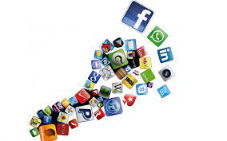
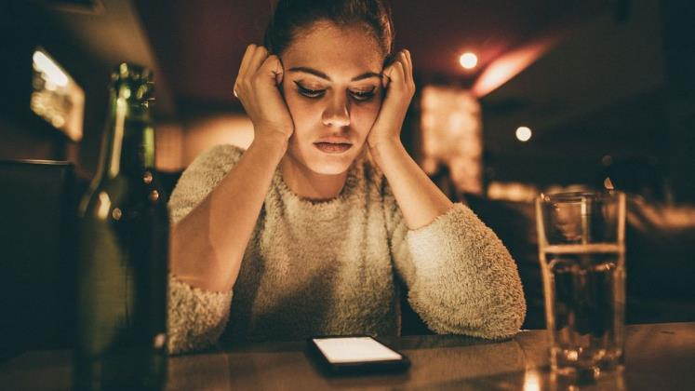
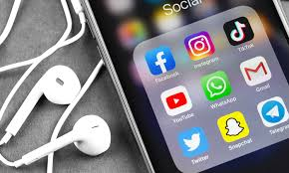
#LikeMinded
Social Media
Researchers from Harvard University and the University of Vermont used these techniques in their recent analysis of almost 44,000 Instagram posts. Their resulting models correctly identified 70% of all users with depression. compared to a rate of 42% from general practitioners. They also had fewer false positives (although this figure drew from a separate population, so may be an unfair comparison). Depressive signals were evident in users’ feeds even before a formal diagnosis from psychiatrists – making Instagram an early warning system of sorts.
Telling signals of depression include an increase in negative words (“no”, “never”, “prison”, “murder”) and a decrease in positive ones (“happy”, “beach”, and “photo”), but these are hardly definitive. Taking it a step further, researchers at Harvard University, Stanford University and the University of Vermont extracted a wider range of features (mood, language and context) from almost 280,000 tweets. The resulting computational model scored highly on identifying users with depression; it also was correct in about nine of every 10 PTSD predictions.
Key Vocabulary
resulting models
general practitioners
diagnosis
psychiatrists
disjointed
tangential
schizophrenia
pessimistic
computational
Meanwhile, psychiatrists have long linked language and mental health, listening for the disjointed and tangential speech of schizophrenia or the increased use of first-person singular pronouns of depression.
From my 1017 most recent words on Twitter, I’m apparently average for being angry and worried but below average on being upbeat – I have
been pretty pessimistic about the state of the world recently.
Discussion Point
What would your social media posts suggest about your mental well-being?
Find five emotive words from your social media feed. Are their positive or negative words?
Is social media a good place to visit when you’re feeling vulnerable or down? Explain your answer.
Text Source: https://www.bbc.com/future/article/20180201-how-your-social-media-betrays-your-mood
Notes:
July 2021. Kindly contributed to www.skillsworkshop.org by Nikki Milton, Cambridge Regional College.

Slide 6
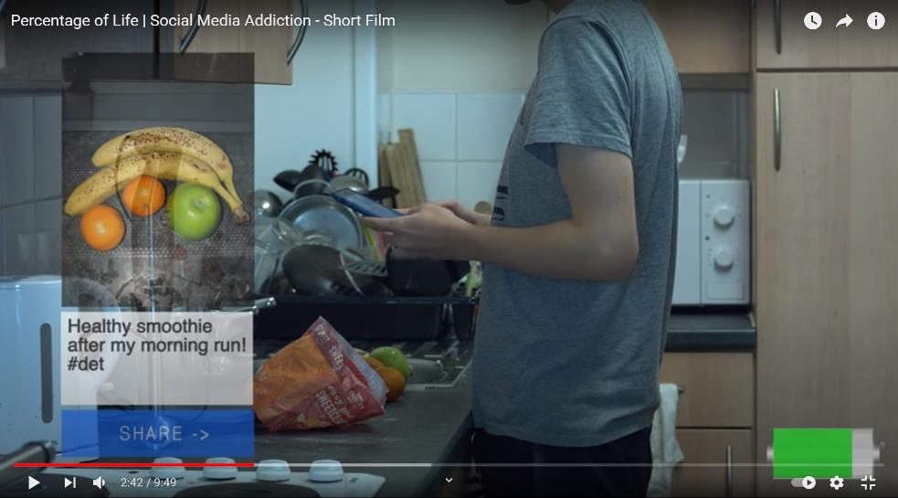
Social Media
Are you a social media addict?
Describing yourself as ‘a social media addict’ doesn’t usually inspire concern from other people. In fact, it’s frequently included in bio descriptions on Twitter and Instagram. Decorate your LinkedIn profile with such a claim and you may even find yourself receiving interest from media and publishing companies searching for a savvy digital native. But imagine if, one day, it’s not an accolade or joke at all – but a psychiatrist’s diagnosis?
Social media addiction has been a much-flouted term lately; maybe it’s because it’s January and users are looking to be more active and spend less time online, or maybe that’s because social media can have a negative impact on our mental well-being. But a growing body of research is seriously considering whether problematic and excessive social media usage could be pathological and, in turn, designated as a mental health disorder.
Key Vocabulary
savvy digital native
accolade
much-flouted
pathological
There are two established organisations which classify mental disorders – the World Health Organisation (WHO) and the American Psychiatric Association. Any alleged addiction needs to fit certain criteria before it’s considered pathological behaviour, and there needs to be a vast amount of research that confirms it. It was only announced in January 2018 that video gaming addiction – a problem as old as the internet itself – will be listed by the WHO as a disorder.
Discussion Point
What is the message within the short film ‘Percentage of Life’?
What similarities are there between this text and the video? Can you give examples to support your point?
How long can you go without checking your social media accounts?
What do you think constitutes a social media addict?
#LikeMinded
Text Source: https://www.bbc.com/future/article/20180118-how-much-is-too-much-time-on-social-media
Video Source: https://www.youtube.com/watch?app=desktop&v=0Y6v_1dwF3c
Notes:
July 2021. Kindly contributed to www.skillsworkshop.org by Nikki Milton, Cambridge Regional College.

Slide 7
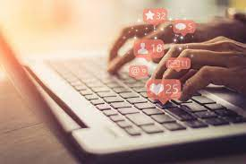
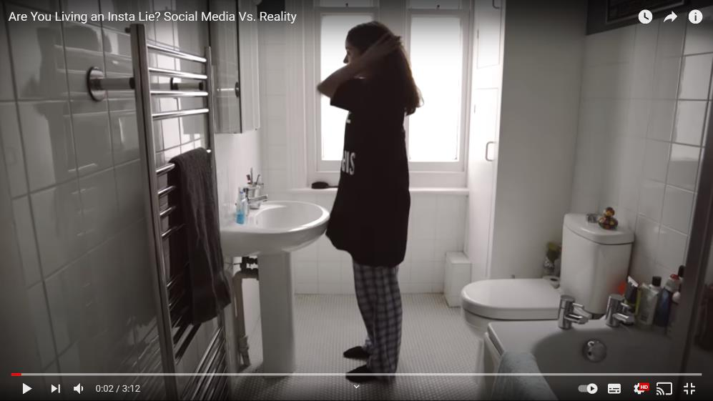
Social Media
Are you Living an Insta Life? Social Media Vs. Reality
#LikeMinded
Writing Task
Write an article about the use of social media replacing face-to-face interaction among many people in society. You should:
Discuss the advantages and disadvantages of social media
Consider whether the advantages outweigh the disadvantages?
The power of influence social media has on your contacts
Give your opinions and persuade people to agree with you.
You should aim to write about 250 to 300 words.
Discussion Point
Are all your online posted pictures a true reflection of your life?
What have you posted that tell a different story about your day?
Why do you think people post pictures that give their audience a different impression about their lives?
Why are reactions to photos and posts so important to people?
Video Source: https://www.youtube.com/watch?v=0EFHbruKEmw
Notes:
July 2021. Kindly contributed to www.skillsworkshop.org by Nikki Milton, Cambridge Regional College.

Slide 8
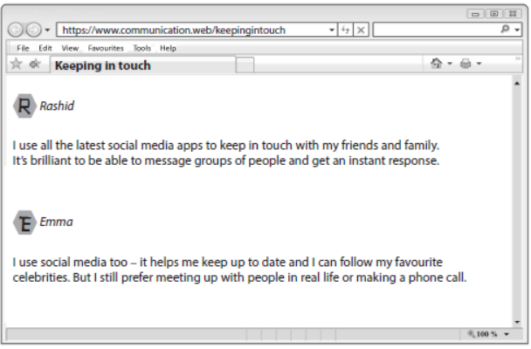
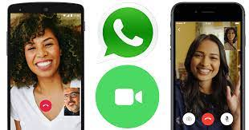
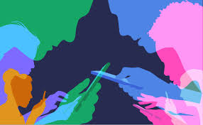
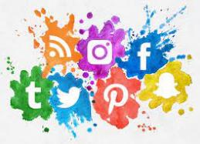
Social Media
Writing Task
Write a contribution to the web forum about how you keep in touch with people.
In your contribution, you should:
give your views on using social media to keep in touch with people
describe how you prefer to communicate
You should aim to write about 200 to 250 words.
#LikeMinded
Video Source: https://www.youtube.com/watch?v=0EFHbruKEmw
Notes:
July 2021. Kindly contributed to www.skillsworkshop.org by Nikki Milton, Cambridge Regional College.

