Slide 1
L2 Functional Skills English reading Skills building – comparing texts
September 2021. Kindly contributed by Nikki Milton, Cambridge Regional College.
Search for Nikki on www.skillsworkshop.org
Please refer to the download page for this resource on skillsworkshop for detailed curriculum links and related resources. https://www.skillsworkshop.org/resources/skills_building_comparing_texts
For full use of hyperlinks and other features, this presentation should be run in full screen mode.
Covers several Level 1 & 2 Reformed Functional Skills English reading content descriptors, including
L1.10 Compare information, ideas and opinions in different texts
L2.12 Compare information, ideas and opinions in different texts, including how they are conveyed
Source: DfE (Feb 2018), Subject content functional skills: English https://www.gov.uk/government/publications/functional-skills-subject-content-english
GCSE English reading curriculum links:
A3 Compare writers’ ideas and perspectives, as well as how these are conveyed, across two or more texts.
Source: DfE (2013), English Language GCSE subject content and assessment objectives: https://www.gov.uk/government/publications/gcse-english-language-and-gcse-english-literature-new-content
Many thanks to CGP Books for permission to reproduce the texts on slides 12 and 13. https://www.cgpbooks.co.uk/
Notes:
September 2021. Kindly contributed to www.skillsworkshop.org by Nikki Milton, Cambridge Regional College.
1

Slide 2
Skills Building
Comparing Texts
L1.10 | Compare information, ideas and opinions in different texts
L2.12 | Compare information, ideas and opinions in different texts, including how they are conveyed
Key Vocabulary
compare | Note the similarity or dissimilarity between
similarity | A similar feature or aspect
dissimilarity | Difference or variance
conveyed | To express a thought, feeling or idea so that it is understood by other people
Notes:
September 2021. Kindly contributed to www.skillsworkshop.org by Nikki Milton, Cambridge Regional College.

Slide 3
Skills Building
Level 1
Level 2
Question 15
You are asked to compare two texts and find a piece of information that is the same in both texts.
You must then give the quote from each text that shows the information is the same.
Worth three marks one mark for the information that is the same and then one mark for each quote
Question 13
This is your big mark question!
You are asked to look at two of the texts and find similar ideas from the text. You must then give a quote from each of the texts to evidence these similarities.
Worth six marks – one mark for each similarity
two marks for each quote
Evidence from Source 1
Evidence from Source 1
Similarity 1
Evidence from Source 1
Evidence from Source 1
Similarity
Evidence from Source 1
Evidence from Source 1
Similarity 2
Question breakdown based on Edexcel Functional Skills English Qualifications
Notes:
September 2021. Kindly contributed to www.skillsworkshop.org by Nikki Milton, Cambridge Regional College.

Slide 4
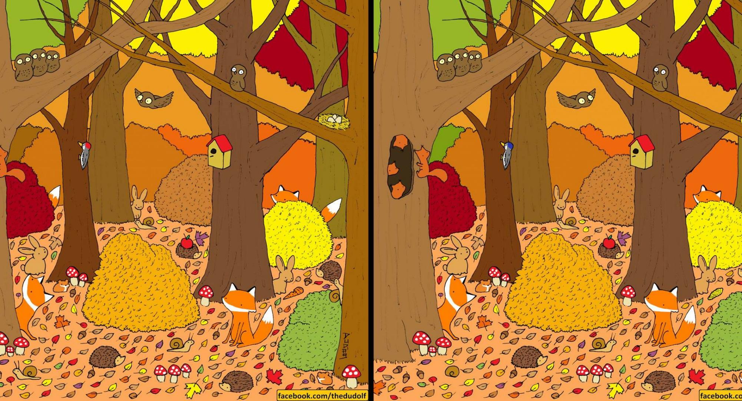
Skills Building
There are 14 differences. Can you spot at least 4?
How many similarities can you find? What are they?
Source: https://www.mentalfloss.com/article/642229/spot-difference-pictures-autumn-forest
Notes:
September 2021. Kindly contributed to www.skillsworkshop.org by Nikki Milton, Cambridge Regional College.

Slide 5
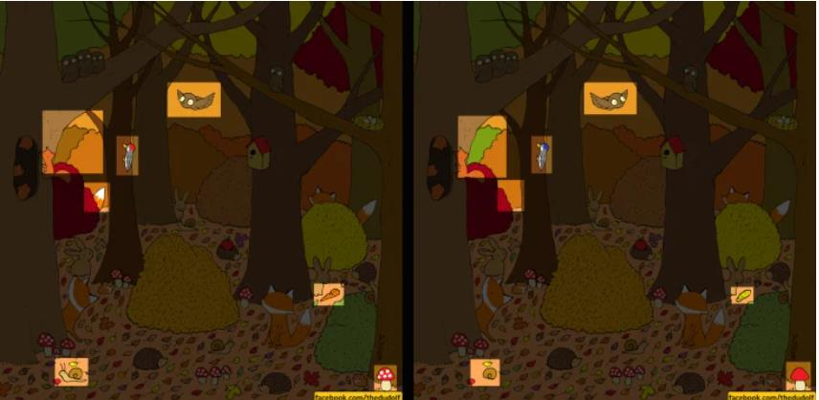
Skills Building
Here are the 14 differences. Did you find them all?
Source: https://www.mentalfloss.com/article/642229/spot-difference-pictures-autumn-forest
Notes:
September 2021. Kindly contributed to www.skillsworkshop.org by Nikki Milton, Cambridge Regional College.

Slide 6
Skills Building
Similarities found include:
It is Autumn in both pictures
A warm and sunny day
Evidence which has helped us make these observations:
Colours of red, orange, brown and yellow
Fallen leaves on the ground
Source: https://www.mentalfloss.com/article/642229/spot-difference-pictures-autumn-forest
Notes:
September 2021. Kindly contributed to www.skillsworkshop.org by Nikki Milton, Cambridge Regional College.

Slide 7
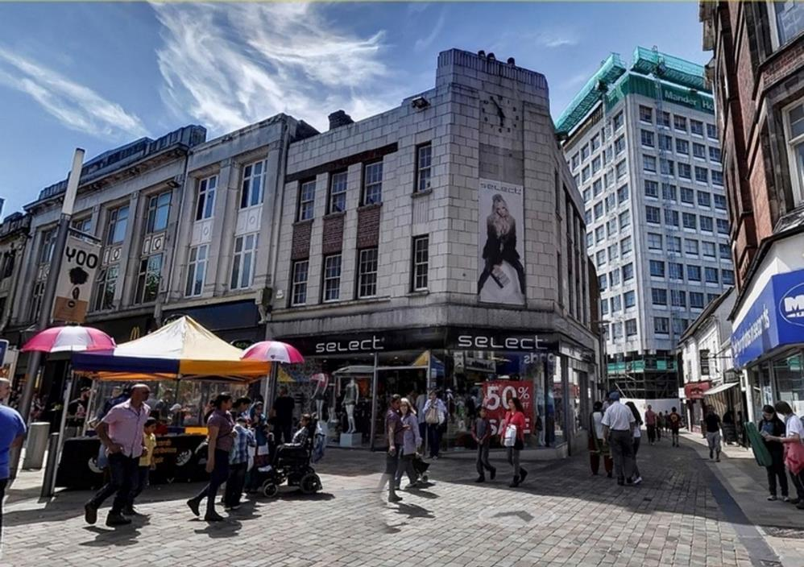
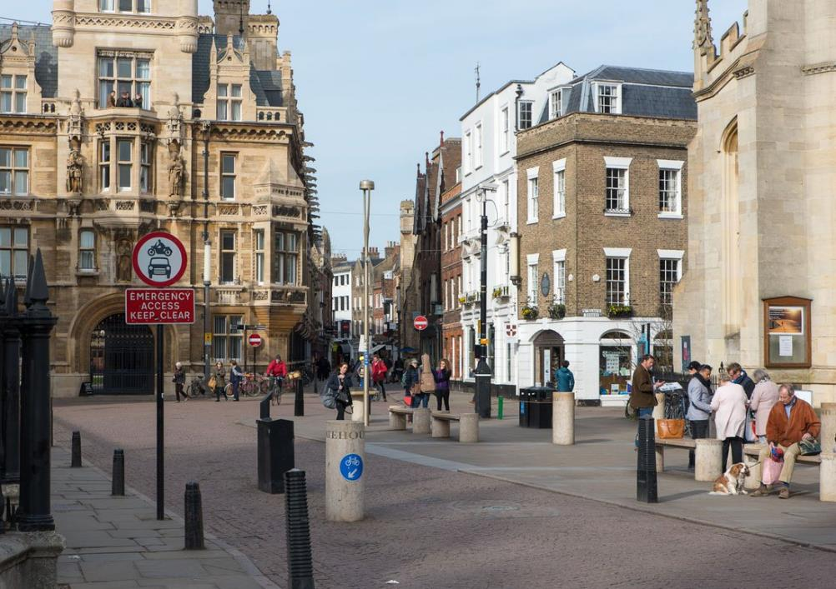
Skills Building
How many dissimilarities can you find? What are they?
What is similar about these town centres? What evidence supports your idea?
Similarity
Evidence from Image 1
Evidence from Image 2
Notes:
Photo 1: Wolverhampton Town Centre (sourced via Google images)
Photo 2: Cambridge Town Centre (sourced via Google images)
September 2021. Kindly contributed to www.skillsworkshop.org by Nikki Milton, Cambridge Regional College.

Slide 8
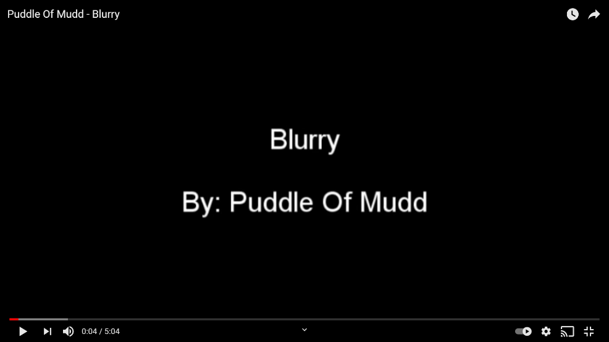
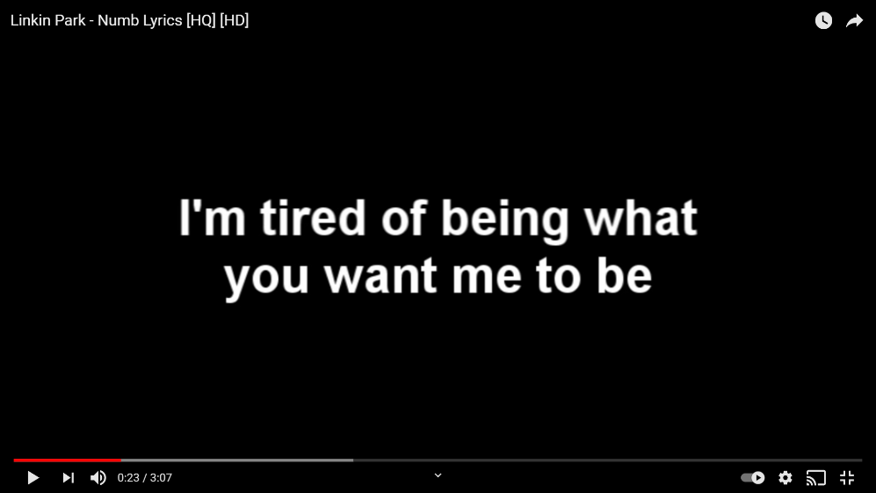
Skills Building
What themes do these songs both share?
What evidence supports your idea?
Similarity 1
Evidence from Video 1
Evidence from Video 2
Similarity 2
Evidence from Video 1
Evidence from Video 2
Video sources: https://www.youtube.com/watch?v=znFArjTUCdQ ; https://www.youtube.com/watch?v=-qZxMY7FZf8
Notes:
September 2021. Kindly contributed to www.skillsworkshop.org by Nikki Milton, Cambridge Regional College.

Slide 9
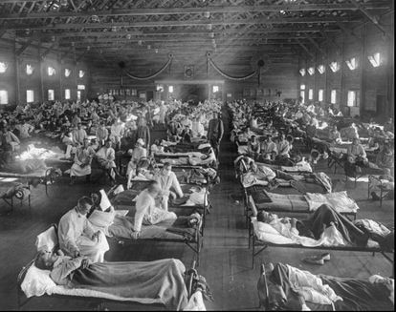
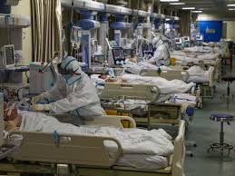
Skills Building
Can you identify when and where these images are taken?
What is going on? What themes do they both share?
What evidence in the pictures support your ideas?
Similarity
Evidence from Image 1
Evidence from Image 2
Sources: https://www.nhs.uk/conditions/coronavirus-covid-19/how-to-avoid-catching-and-spreading-coronavirus-covid-19/ ; https://english.elpais.com/society/2020-03-26/coronavirus-deaths-in-spain-now-exceed-4000-with-655-in-just-24-hours.html ; https://english.elpais.com/society/2020-03-27/the-surprising-similarities-between-the-spanish-flu-and-the-coronavirus-pandemic.html
Notes:
September 2021. Kindly contributed to www.skillsworkshop.org by Nikki Milton, Cambridge Regional College.

Slide 10
Skills Building
A reminder of how you structure your answer for each level
Similarity
Evidence from Text A
Evidence from Text B
Level 1
Similarity 1
Evidence from Text A
Evidence from Text B
Level 2
Similarity 2
Evidence from Text A
Evidence from Text B
Notes:
September 2021. Kindly contributed to www.skillsworkshop.org by Nikki Milton, Cambridge Regional College.

Slide 11
Skills Building
Text A: The Spanish Flu, 1918
The initial response to the 1918 outbreak was to play it down, and later efforts at disinfection and social distancing proved insufficient to stop the spread of a disease that killed over 147,000 in Spain in one year. More than 100 years ago, when a flu-like disease emerged, the initial response was to laugh it off. On May 22, 1918, the front page of the Spanish newspaper ABC reported on a new illness, described as similar to the flu but with milder symptoms. That same month, Madrid held its annual San Isidro festivities, providing the perfect conditions for mass contagion. The new flu was lightheartedly christened Soldado de Nápoles (Soldier of Naples) after a song in a popular operetta of the day which, like the new disease, was extremely “catchy.” The Spanish flu pandemic of 1918, the deadliest in history, infected an estimated 500 million people worldwide—about one-third of the planet’s population—and killed an estimated 20 million to 50 million victims, including some 675,000 Americans.
Text B: Coronavirus (COVID-19)
On 31 December 2019, the World Health Organisation (WHO) was informed of a cluster of cases of pneumonia of unknown cause detected in Whan City, Hubai Province, China. On 12 January 2020, it was announced that a novel coronavirus had been identified in samples obtained from cases and that initial analysis of virus genetic sequences suggested that this was the cause of the outbreak. This virus is referred to as SARS-CoV-2, and the associated disease as COVID-19. As of 22 February 2021, over 109 million cases have been diagnosed globally with more than 2.4 million fatalities. In the 14 days to 17 February, more than 5.7 million cases were reported. Human-to-human transmission is occurring extensively. Hence, precautions to prevent human-to-human transmission are appropriate for both suspected and confirmed cases. While there are cases of coronavirus (COVID-19) in the UK, there is a risk you can catch it or pass it on. You could still catch it or spread it even if you’re fully vaccinated. There are things you can do to reduce your risk of catching the virus or spreading it to other people. Do: Get vaccinated Meet people outside if possible Open doors and windows to let in fresh air if meeting people inside Limit the number of people you meet and avoid crowded places Wear a face covering when it’s hard to stay away from other people – particularly indoors or in crowded places Wash your hands with soap and water or use hand sanitiser regularly throughout the day
Making Connections…
In pairs, discuss what these two texts have in common? Can you prove this with evidence from the text? Remember how to structure your answer.
Sources: https://www.nhs.uk/conditions/coronavirus-covid-19/how-to-avoid-catching-and-spreading-coronavirus-covid-19/ ; https://english.elpais.com/society/2020-03-26/coronavirus-deaths-in-spain-now-exceed-4000-with-655-in-just-24-hours.html ; https://english.elpais.com/society/2020-03-27/the-surprising-similarities-between-the-spanish-flu-and-the-coronavirus-pandemic.html
Notes:
September 2021. Kindly contributed to www.skillsworkshop.org by Nikki Milton, Cambridge Regional College.

Slide 12
Skills Building
To:
Frances.jones@azmail.co.uk
Naomi and Frances gave different ideas about their trips abroad. a) Compare how the ideas about Mexico are different between the two emails, using an example from each email to support your answer.
Subject:
Trip to Mexico
Dear Frances,
I am so glad to be back in England. I really didn’t have a great time on my trip.
The heat was unbearable, and I found the cities overcrowded and far too noisy. The streets were lined with litter and I just found the place incredibly dreary and depressing. I was expecting to be blown away by the countryside but, while it was stunning at times, I was left disappointed by how bare much of it was. To be fair, all the people I met were extremely friendly and helpful. I don’t think I will be going back, although I am glad I went. Anyway, I hope we can arrange to meet soon!
See you around!
Naomi
Evidence from Email 1
Evidence from Email 2
difference
To:
Frances.jones@azmail.co.uk
Subject:
Trip to Mexico
b) Show a difference in the way that ideas about Mexico are conveyed in the emails, using an example from each email to support your answer.
Dear Naomi,
Oh No! I’m sorry to hear that. We must meet up and chat about it.
I had a really good time when I was in Mexico. I found it to be a beautiful country that is full of life. I know what you mean about everyone being friendly – there were so many smiling faces! I only went to quieter places and found the landscape to be beautiful in an expansive, empty kind of way. I did also explore other parts of the country and there were vast mountain ranges and rolling hills. Maybe you went at the wrong time of year? I wouldn’t recommend checking out the countryside in summer.
See you soon!
Frances
Evidence from Email 1
Evidence from Email 2
difference
Source: CGP Functional Skills English Level 2: New! 10-Minute Tests ISBN 9781789084870
Notes:
September 2021. Kindly contributed to www.skillsworkshop.org by Nikki Milton, Cambridge Regional College.

Slide 13
Skills Building
Members – have your say!
Post a reply
Start a new thread
Why are our trains cancelled so often?
Mo
Forum Member
Posted: 27th October 16:12
Compare how the ideas about rail travel are similar between the two forum posts. Use an example from each post to support your answer.
I am so fed up with the trains in the UK constantly being delayed or cancelled for seemingly no reason. I was stunned to hear that my last train had been delayed because of “leaves on the line” when I was visiting my father. How can a train be stopped by leaves? I can see how ice could be a problem but not leaves or heat. I do realise that the transport system must be quite difficult to manage, but it just seems to shut down far too easily. I went to Japan last year and the trains were running during a massive snowfall. If other countries’ railways can cope with harsh weather, why can’t the railways in the UK? I don’t like to rant, but it is so unbelievably frustrating! Can anyone explain this to me????
Evidence from Forum Entry 1
Evidence from Forum Entry 2
difference
Why are our trains cancelled so often?
Evidence from Forum Entry 1
Evidence from Forum Entry 2
difference
Stefan
Forum Member
Posted: 27th October 17:02
I’ve had similar experiences when travelling by train and I agree that it can be hugely annoying! I am afraid that I can’t offer any explanation as to why leaves cause a delay, but I know heat can cause serious problems. Heat causes the metal tracks to expand and eventually buckle and curve. This is why sometimes trains are cancelled when it’s really hot – the overheated tracks are not fit to have trains running on them! However, it is still worth sticking with British trains. Trains are still an incredibly popular way to travel around the UK, and they are also far more environmentally friendly than cars. British railways aren’t all bad – they’re among the top 10 railways in Europe. Keep the faith Mo!
Source: CGP Functional Skills English Level 2: New! 10-Minute Tests ISBN 9781789084870
Notes:
September 2021. Kindly contributed to www.skillsworkshop.org by Nikki Milton, Cambridge Regional College.

Slide 14
Skills Building
Comparing Texts
L1.10 | Compare information, ideas and opinions in different texts
L2.12 | Compare information, ideas and opinions in different texts, including how they are conveyed
Key Vocabulary
compare | Note the similarity or dissimilarity between
similarity | A similar feature or aspect
dissimilarity | Difference or variance
conveyed | To express a thought, feeling or idea so that it is understood by other people
Notes:
September 2021. Kindly contributed to www.skillsworkshop.org by Nikki Milton, Cambridge Regional College.

