Slide 1
L1-2 Functional Skills English Mobile phones: reading, writing and discussion
July 2021. Kindly contributed by Nikki Milton, Cambridge Regional College.
Search for Nikki on www.skillsworkshop.org
Please refer to the download page for this resource on skillsworkshop for detailed curriculum links and related resources. https://www.skillsworkshop.org/resources/mobile_phones
For full use of hyperlinks and other features, this presentation should be run in full screen mode.
Covers many Reformed Functional Skills English content descriptors, including:
Speaking, listening and communication: L1.5 Express opinions and arguments and support them with evidence L1.6 Follow and understand discussions and make contributions relevant to the situation and the subject L2.5 Communicate information, ideas and opinions clearly and effectively, providing further detail and development if required | Reading: L1.10 Compare information, ideas and opinions in different texts L1.11 Identify meanings in texts and distinguish between fact and opinion L1.15 Infer from images meanings not explicit in the text L1.16 Recognise vocabulary typically associated with specific types and purposes of texts (e.g. formal, informal, instructional, descriptive, explanatory and persuasive) L1.17 Read and understand a range of specialist words in context L2.15 Use a range of reference materials and appropriate resources (e.g. glossaries, legends /keys) for different purposes, including to find the meanings of words in straightforward and complex sources L2.18 Follow an argument, identifying different points of view and distinguishing fact from opinion | Writing: L1.22 [L2.23] Communicate information, ideas and opinions clearly, coherently and accurately L1.23 [L2.24] Write text of an appropriate level of detail and of appropriate length (including where this is specified) to meet the needs of purpose and audience L1.24 Use format, structure and language appropriate for audience and purpose
Notes:
July 2021. Kindly contributed to www.skillsworkshop.org by Nikki Milton, Cambridge Regional College.
1

Slide 2
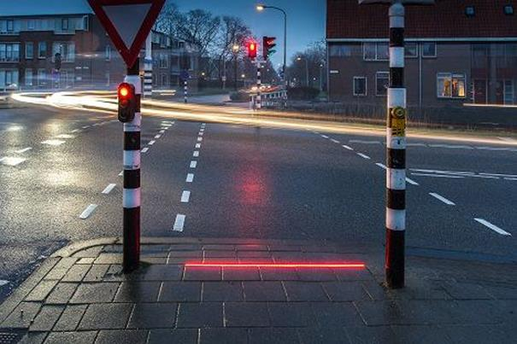
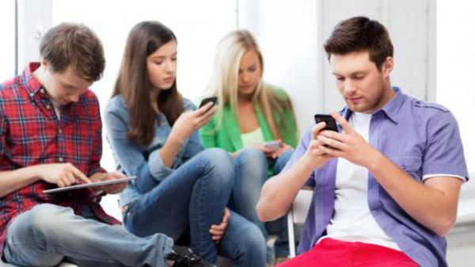
Mobile Phones
What can you see in the picture?
Key Vocabulary
petextrian
smombie
phubber
FOMO
What is the purpose of this?
What do you think of when you hear the word ‘smobie’?
Inference…
What is happening in this picture? What kind of relationship do they all have with each other?
#smombie
Making Connections…
What is the connection between these two images?
Notes:
July 2021. Kindly contributed to www.skillsworkshop.org by Nikki Milton, Cambridge Regional College.

Slide 3
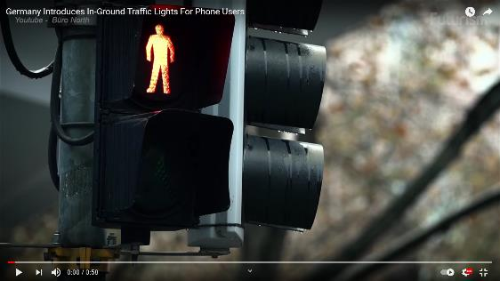
#smombie
Mobile Phones
Being a petextrian can be fatal!
A small city in southern Germany may be the first place in the world to introduce in-ground traffic lights.
The move by authorities in Augsburg comes in response to distracted smartphone users increasingly putting themselves at risk by not looking up while crossing roads.
In March 2016, a 15-year-old girl died after being struck by a tram as she was crossing at a red light.
Local media reported that she was looking at her phone and listening to music through headphones when she was hit.
The flashing LEDs have been installed at two crossings in the city where university students frequently access public transport.
Authorities will monitor the lights before deciding whether to roll them out across the rest of the city, a spokeswoman told German broadcaster NTV.
Have you ever walked
Nearly 3,500 pedestrians in Australia are seriously injured each year.
Fact finding…
Can you identify 3 facts on this slide? How do we know that they are facts?
Key Vocabulary
authorities
tram
pavement hoggers
“Whilst this may be the first example of traffic signals specifically targeting those glued to their screens, Augsburg is not the first city to take action in response to distracted mobile phone users.”
A shopping mall in Liverpool introduced pedestrian fast lanes last year, so that "pavement hoggers" and "dawdling pedestrians" did not get in the way of others.
What’s your opinion?
What is your opinion on the injuries and deaths related to petextrians?
Video source: https://www.youtube.com/watch?v=NN7Nh1KacSQ
Text source: https://www.abc.net.au/news/2016-04-27/german-town-introduces-in-ground-traffic-lights-for-pedestrians/7363414
Notes:
July 2021. Kindly contributed to www.skillsworkshop.org by Nikki Milton, Cambridge Regional College.

Slide 4
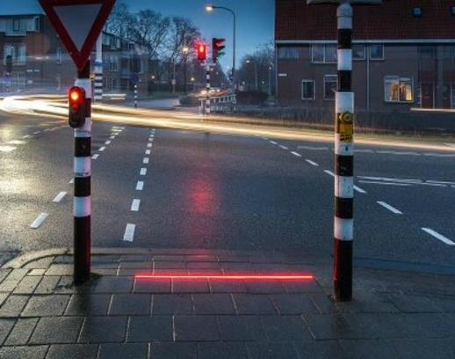
Mobile Phones
A town in the Netherlands is trialling special pavement lights designed to help smartphone users cross the road safely.
The LED strips have been embedded into the ground at a pedestrian crossing in Bodegraven, close to three schools.
The hope is that they’ll catch the eye of pedestrians who are too distracted by their smartphones to bother looking at the road, telling them when to cross and when not to cross by either glowing green or red, depending on the traffic light signals.
“Social media, games, WhatsApp and music are major distractions in traffic,” said councillor Kees Oskam. “We may not be able to change this trend, but we can anticipate problems.”
TRAFFIC LIGHTS BUILT INTO PAVEMENT
The system, called +Lichtlijn (+Lightline), was developed by local firm HIG Traffic Systems, and has attracted criticism from the Dutch Traffic Safety Association, VVN.
FOR SMARTPHONE-USING
PEDESTRIANS IN NETHERLANDS
“It's not a good idea to help mobile phone users look at their phones,” said VVN’s Jose de Jong.
“We don't want people to use phones when they're dealing with traffic, even when walking around. People must always look around them, to check if cars are actually stopping at the red signals.”
According to DutchNews, a VVN spokesman accused the system of “rewarding bad behaviour”.
HIG plans to roll +Lichtlijn out more widely if the trial proves successful.
Informal vs formal…
Give 2 examples of informal language and 2 examples of formal language used in this slide.
That’s your opinion…
Can you identify 3 opinions on this slide? How do we know that they are opinions? Do you notice anything interesting about them?
What do they have in common?
After reading about traffic lights built into the pavement in Germany and Netherlands, do the texts have the similar ideas or messages? Can you find 2 similarities between the texts? Can you find a quote from each slide to support your claims?
#smombie
Text Source: https://www.independent.co.uk/life-style/gadgets-and-tech/news/traffic-lights-pavement-smartphone-users-look-down-dutch-pedestrians-netherlands-a7584081.html
Notes:
July 2021. Kindly contributed to www.skillsworkshop.org by Nikki Milton, Cambridge Regional College.

Slide 5
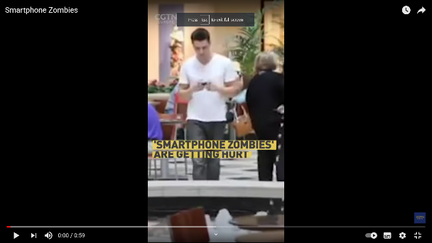
Mobile Phones
Are we rewarding smobie bad behaviour?
Checklist for success…
Does my letter have a clear start, middle and end? Does my writing have organisational markers where appropriate? Have I used a wide range of punctuation e.g. apostrophes, colons, bullet points, semi-colons, exclamation marks and speech marks where appropriate? Have I used vocabulary, language devices, tone and style effectively to persuade/convince my audience? Have I proofread my writing to ensure that my points are clear?
Information
Your local council has been concerned about the rise in phone related injuries around town. They have decided to trial pavement traffic light system in the vicinity of further education colleges.
#smombie
Your task…
Write a letter to your local MP, Lucy Hedge, expressing your viewpoint. In your letter you should: Share your observations of petextrians around town Give your views on whether you think that traffic lights built into the pavement for smartphone using pedestrians is rewarding bad behaviour Share an anecdotal story within your letter about your own experiences as a smart phone using pedestrian.
Notes:
July 2021. Kindly contributed to www.skillsworkshop.org by Nikki Milton, Cambridge Regional College.

Slide 6
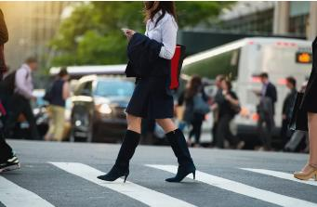
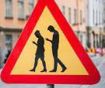
#smombie
Mobile Phones
Should walking and texting on the streets be banned?
What about here in the UK?
You can get 6 penalty points and a £200 fine if you use a hand-held phone when driving. You’ll also lose your licence if you passed your driving test in the last 2 years. You can get 3 penalty points if you don’t have a full view of the road and traffic ahead or proper control of the vehicle. You can also be taken to court where you can: be banned from driving or riding get a maximum fine of £1,000 (£2,500 if you’re driving a lorry or bus) To date, there are no legislations to address the smartphone zombies in the UK.
“It's one of the most annoying things in the modern city. You're on the pavement stuck behind a dawdling walker, whose attention isn't even on the street ahead. Instead their head is tilted downwards, eyes firmly locked on their smartphone.”
Will Rogers (actor) famously wrote, "You can't legislate intelligence and common sense into people." And yet, several cities and states are considering doing just that when it comes to people who walk while texting.
Key Vocabulary
legislate
fatalities
Penalty points
A law passed in Honolulu allows police officers to fine pedestrians between $15 and $99 for staring at their phone while crossing a street.
The town of Montclair, California, took it one step further and passed a law in January 2018 making it illegal to talk, text or have earbuds plugged into your phone when crossing the street. For first-time offences, people will be given a warning. After that, the fine is $100.
Farther north in Ontario, under the proposed “Phones Down, Heads Up Act," pedestrians can be fined if caught crossing the road while holding and using a phone or any other type of communication device. Fines start at $50 for the first offence. The bill, nicknamed the "zombie law," passed in March 2018.
Think. Pair. Share…
In pairs, research what Japan does to address the problem of walking while texting. What is their solution? Which method do you think is most effective and why?
This movement to legislate distracted walking has a purpose: Pedestrian fatalities are on the rise. According to the National Safety Council, there were 5,987 pedestrian fatalities in 2016 — the highest number since 1990 and a 9% increase over 2015.
Text Source 1: https://www.treehugger.com/texting-while-walking-should-it-be-banned-4863863 Text Source 2: https://www.gov.uk/using-mobile-phones-when-driving-the-law
Notes:
July 2021. Kindly contributed to www.skillsworkshop.org by Nikki Milton, Cambridge Regional College.

Slide 7
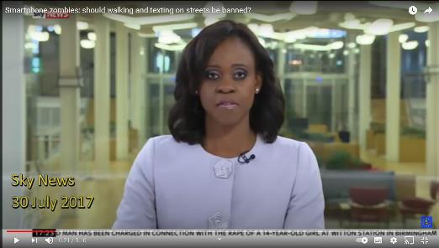
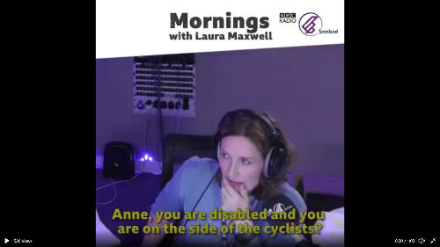
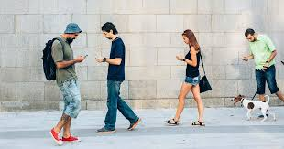
Mobile Phones
Cause for concern…
Key Vocabulary
compensation
collision
counterclaim
evolved
In 2019, cyclist Robert Hazeldean was made to pay compensation to a woman he was involved in a collision with. Robert was on his bicycle and the woman was walking and texting on her phone.
The judge in the case decided that both parties were to blame, but Hazeldean had to pay compensation because he hadn’t entered a counterclaim against the pedestrian. A crowdfunding campaign was organised to raise money for Hazeldean’s legal fees.
Group Task…
In groups of 3 or 4 discuss the situation of smartphone zombies. Do you think this is a growing issue in the UK? What should be done about it? Should we adopt some of the practices used in other countries?
Do you agree?
Do you think both people are at fault or, like Anne, that the woman walking on her phone was at fault? Do you agree with the scientists? Are we able to cope with walking and texting? Be prepared to explain your answer.
#smombie
Scientists say humans ‘evolved’ to cope with walking and texting. (From 2015)
Video Source: https://www.youtube.com/watch?v=oUOcQMYS8EI&t=31s
Text Source: https://www.bbc.co.uk/programmes/articles/2hg9gPbWsKnWXjJJc8lrl3L/should-texting-on-your-phone-while-walking-be-made-illegal
Notes:
July 2021. Kindly contributed to www.skillsworkshop.org by Nikki Milton, Cambridge Regional College.

Slide 8
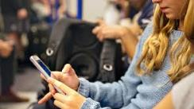
#smombie
Mobile Phones
Where else are smombies becoming a problem?
you've probably noticed the extent to which students are glued to their mobile devices. What do they do with them when they walk into the classroom? In a recent survey, college students reported using their phones an average of 11 times per day in class. In another study, 92% of college students reported using their phones to send text messages during class.
Whether laptops should be allowed in the classroom may be a bit more nuanced, as some students prefer to take notes on their computer. However, the temptation for distraction is large. Most students using a computer in class spend considerable time on activities not related to taking notes, and furthermore identified a negative correlation between student success in class and in-class laptop use.
What’s the point?
What is the purpose of this text? a) To explain b) To describe c) To instruct c) To persuade
Broadly, we are not wired to multitask well and using cell phones during class is no exception. Several studies have compared students who texted during a lesson versus those who did not. Those who texted frequently took lower quality notes, retained less information, and did worse on tests about the material. Students themselves realise that mobile phone usage does not promote learning; in one survey, 80% of students agreed that using a mobile phone in class decreases their ability to pay attention.
What is worse is that mobile device usage is distracting to neighbouring students. In several surveys, students have reported that texting is distracting to nearby students. A study on laptops in a simulated classroom found that students in the vicinity of another student who was multitasking on a laptop during class scored worse on a test than those who were not near multitaskers. While cell phone screens are smaller—and thus perhaps less distracting—than a laptop, one could reasonably expect that a similar phenomenon of distraction applies to cell phones.
Finally, what is the answer? So, students are on Facebook instead of hanging off their teacher’s every word. Or shopping on Amazon. Or watching the latest viral video. There's a solution: incorporate social media into lessons. Crowd sourcing questions using social media and see what your friends know about a topic. Being quizzed using clickers before and during lessons. Most importantly, digital tools must be accessible to different students.
Key Vocabulary
simulated
phenomenon
instantaneous
nuanced
correlation
incorporate
On the other hand, smart phones and other mobile devices can be used for positive purposes in the classroom. For example, teachers might choose to employ a variety of applications, which can be accessed by mobile devices. These applications encourage class participation and provide teachers with instantaneous feedback about learning.
Switching it up…
Re write this article as a persuasive email to a friend to convince them to stop using their mobile device next to you in class.
As easy as 1, 2, 3…
What joining words, and phrases have been used to put the points of this text in order?
Text Source: https://bokcenter.harvard.edu/technology-and-student-distraction
Notes:
July 2021. Kindly contributed to www.skillsworkshop.org by Nikki Milton, Cambridge Regional College.

