Slide 1
L1-2 ESOL and Functional Skills English The Man in the Last House Standing
October 2022. Kindly contributed by Matt Lunt, The City of Liverpool College.
Search for Matt on www.skillsworkshop.org
Please refer to the download page for this resource on skillsworkshop for detailed curriculum links and many related resources including: role/discussion card, lesson plan/answers, two worksheets with links to news reports, a sample audio file with transcript, and a transcript of the BBC News video.
https://www.skillsworkshop.org/resources/the_man_living_in_the_last_house_standing
For full use of hyperlinks and other features, this presentation should be run in full screen mode.
Covers many ESOL and Functional Skills English ICT criteria, including:
ESOL: Sc/L1.2b Ask for information Sc/L1.4a Present information and ideas in a logical sequence Sd/L1.2a Express views and opinions Lr/L1.1a Extract information from texts of varying genre, e.g. radio, TV Lr/L1.1b extract relevant information from a narrative or explanation, and respond Rw/L1.2a Recognise & understand vocabulary associated with different types of text, using appropriate strategies to work out meaning Sc/2.3b Ask for information Sc/L2.4a Express statements of fact Sc/L2.5a Present information & ideas in a logical sequence and provide further detail Sd/L2.2c Express views, opinions, feelings, wishes Lr/L2.1a Extract information from extended texts in a non-face-to-face context, e.g. radio Lr/L2.4a Follow and participate in a discussion or conversation Adult ESOL Core Curriculum (DfES, 2001) https://www.excellencegateway.org.uk/content/etf1194 Sc = Speak to communicate Sd = Engage in discussion Lr = Listen & respond Rw = Reading (word level) | Functional Skills English L1.1 Identify relevant information & lines of argument in explanations & presentations L1.2 Make requests & ask relevant questions to obtain specific information L1.4 Communicate information / ideas / opinions clearly & accurately on range of topics L1.13 Use reference materials & appropriate strategies for a range of purposes, including to find word meanings L2.1 Identify relevant information from extended explanations or presentations L2.2 Follow narratives & lines of argument L2.5 Communicate information / ideas / opinions clearly / effectively with further detail and development if required L2.3 Respond effectively to detailed or extended questions & feedback L2.4 Make requests & ask detailed & pertinent questions to obtain specific information in a range of contexts Subject content [reformed] functional skills: English (DfE, Feb 2018) https://www.gov.uk/government/publications/functional-skills-subject-content-english
Notes:
October 2022. Kindly contributed to www.skillsworkshop.org by Matt Lunt, The City of Liverpool College
1

Slide 2
The Man in the Last House Standing
Notes:
October 2022. Kindly contributed to www.skillsworkshop.org by Matt Lunt, The City of Liverpool College

Slide 3
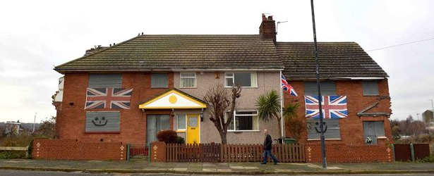
What can you see in the picture?
What does it make you think?
What questions do you want to ask about the picture?
Notes:
October 2022. Kindly contributed to www.skillsworkshop.org by Matt Lunt, The City of Liverpool College

Slide 4
Discuss
How would you describe Charlie as a person?
How would you feel if you had been put in the same situation as Charlie? What do you think you would do?
What words do you think of when you think of the idea of ‘community’? Make a list.
Are there any similar parts of town where you live? Has anything been done to regenerate these areas?
Notes:
October 2022. Kindly contributed to www.skillsworkshop.org by Matt Lunt, The City of Liverpool College

Slide 5
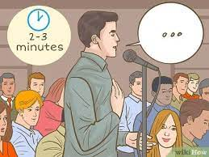
Role Play
The council has invited proposals for how to use the land where Charlie lives. All proposals will be heard at a local consultation meeting today, and the Mayor will have the final decision on which proposal is to be accepted.
Notes:
October 2022. Kindly contributed to www.skillsworkshop.org by Matt Lunt, The City of Liverpool College

Slide 6
Your Role
You will have 2-3 minutes to present your argument.
You have ten minutes to prepare.
Read your role card carefully, and make notes on what you will say.
Try to use some of the target language (in the handout) when arguing your case.
Notes:
October 2022. Kindly contributed to www.skillsworkshop.org by Matt Lunt, The City of Liverpool College

Slide 7
Follow up / Digital skills
Google ‘Charlie Wright Birkenhead’ and see if you can find what happened to him.
Ask for the homework sheet: ‘What happened next’.
Notes:
October 2022. Kindly contributed to www.skillsworkshop.org by Matt Lunt, The City of Liverpool College

