Slide 1
GCSE, and L1-2 Functional English Identifying Language Techniques
March 2021. Kindly contributed by Khansa Patel, Kirklees College.
Search for Khansa on www.skillsworkshop.org
Please refer to the download page for this resource on skillsworkshop for detailed curriculum links and related resources. https://www.skillsworkshop.org/resources/identifying_language_techniques
You can find the answers in a separate PDF file on the same download page.
For full use of hyperlinks and other features, this presentation should be run in full screen mode.
Some lyrics contain strong language.
Reformed Functional English curriculum links:
L1.12 Recognise that language and other textual features can be varied to suit different audiences and purposes
L2.14 Understand the relationship between textual features and devices, and how they can be used to shape meaning for different audiences and purposes
GCSE English curriculum links:
A02 Explain, comment on and analyse how writers use language and structure to achieve effects and influence readers, using relevant subject terminology
Notes:
March 2021. Kindly contributed to www.skillsworkshop.org by Khansa Patel, Kirklees College.
1

Slide 2
Identifying Language Techniques
Notes:
March 2021. Kindly contributed to www.skillsworkshop.org by Khansa Patel, Kirklees College.

Slide 3
You will:
Identify some language techniques that writers use.
Give definitions of the language techniques you have identified.
Write 2 sample sentences for each language technique you identified.
Notes:
March 2021. Kindly contributed to www.skillsworkshop.org by Khansa Patel, Kirklees College.

Slide 4
REVISION: Language techniques you need to recognise. Read and match the colours.
Source: https://missryansgcseenglish.com/2013/05/20/unseen-poetry-essentials/
Notes:
March 2021. Kindly contributed to www.skillsworkshop.org by Khansa Patel, Kirklees College.
Graphic: https://missryansgcseenglish.com/2013/05/20/unseen-poetry-essentials/

Slide 5
What language feature/s can you recognise in the upcoming lyrics?
What are the missing words?

Slide 6
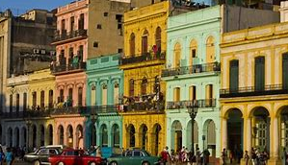
He took me back to East Atlanta All of my ­­­____ is in _______ My ­­­­______ is in Havana.
https://www.youtube.com/watch?v=b91ovTKCZGU

Slide 7
He took me back to East Atlanta All of my ­­­heart is in Havana My ­­heart is in Havana

Slide 8
Q1. Language Feature: __________________
I know this because … -------------------------------------- --------------------------------------
Notes:
March 2021. Kindly contributed to www.skillsworkshop.org by Khansa Patel, Kirklees College

Slide 9
I came in like a wrecking ball.
I never hit so hard in love.
https://www.youtube.com/watch?v=XmZylXo0P_w

Slide 10
Q2. Language Feature: __________________
I know this because … -------------------------------------- --------------------------------------
Notes:
March 2021. Kindly contributed to www.skillsworkshop.org by Khansa Patel, Kirklees College

Slide 11
I mean, we could throw shapes together But it doesn’t mean you’re in my ________ .
https://www.youtube.com/watch?v=RrrdwhHW1zE

Slide 12
I mean, we could throw shapes together But it doesn’t mean you’re in my circle.

Slide 13
Q3. Language Feature: __________________
I know this because … -------------------------------------- --------------------------------------
Notes:
March 2021. Kindly contributed to www.skillsworkshop.org by Khansa Patel, Kirklees College

Slide 14
Happiness can be found even in the darkest of times, if one only remembers to turn on the _______.
https://www.youtube.com/watch?v=zYCx_7J1MDk

Slide 15
Happiness can be found even in the darkest of times, if one only remembers to turn on the light.
Notes:
March 2021. Kindly contributed to www.skillsworkshop.org by Khansa Patel, Kirklees College

Slide 16
Q4. Language Feature: __________________
I know this because … -------------------------------------- --------------------------------------
Notes:
March 2021. Kindly contributed to www.skillsworkshop.org by Khansa Patel, Kirklees College

Slide 17
The wavy trees ______ in the wind, as though they were a well-choreographed troupe.
[No YouTube link]
Notes:
March 2021. Kindly contributed to www.skillsworkshop.org by Khansa Patel, Kirklees College

Slide 18
The wavy trees danced in the wind, as though they were a well-choreographed troupe.
Notes:
March 2021. Kindly contributed to www.skillsworkshop.org by Khansa Patel, Kirklees College

Slide 19
Q5. Language Feature: __________________
I know this because … -------------------------------------- --------------------------------------
Notes:
March 2021. Kindly contributed to www.skillsworkshop.org by Khansa Patel, Kirklees College

Slide 20
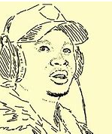
The ting goes skrrrahh! Pap, pap, ka-ka-ka! Skidiki-pap-pap! and a pu-pu-drrr-boom!
https://www.youtube.com/watch?v=3MVoH6elV30
Notes:
March 2021. Kindly contributed to www.skillsworkshop.org by Khansa Patel, Kirklees College

Slide 21
Q6. Language Feature: __________________
I know this because … -------------------------------------- --------------------------------------
Notes:
March 2021. Kindly contributed to www.skillsworkshop.org by Khansa Patel, Kirklees College

Slide 22
Suzy sat sideways. "Shhhh! Sam, Sam! Suzy's sitting sideways!" Simon spoke, softly. "Someone say Suzy?" Said Suzy suddenly. "She's so stupid! Stupid silly Suzy!" scoffed Scott.
[No YouTube link]
Notes:
March 2021. Kindly contributed to www.skillsworkshop.org by Khansa Patel, Kirklees College

Slide 23
Q7. Language Feature: __________________
I know this because … -------------------------------------- --------------------------------------
Notes:
March 2021. Kindly contributed to www.skillsworkshop.org by Khansa Patel, Kirklees College

Slide 24
Veni, Vidi, Vici. I came, I saw, I conquered.
Notes:
March 2021. Kindly contributed to www.skillsworkshop.org by Khansa Patel, Kirklees College

Slide 25
Q8. Language Feature: __________________
I know this because … -------------------------------------- --------------------------------------
Notes:
March 2021. Kindly contributed to www.skillsworkshop.org by Khansa Patel, Kirklees College

Slide 26
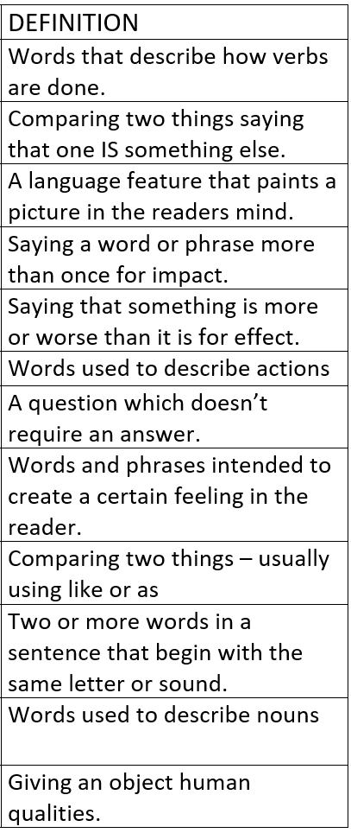
Match up the language technique to the definition
Write an example sentence for each language technique
1
2
3
4
5
6
7
8
9
10
11
12
Source of matching diagram: TES https://www.tes.com/teaching-resource/language-devices-techniques-revision-11339909 (Lizzy Rushton, 2018)
Notes:
March 2021. Kindly contributed to www.skillsworkshop.org by Khansa Patel, Kirklees College.

Slide 27
Extension:
Write 2-3 verses of a song or poem .
Include at least 3 of the language techniques we have talked about.
Notes:
March 2021. Kindly contributed to www.skillsworkshop.org by Khansa Patel, Kirklees College.

