Slide 1
Graffiti artists are not criminals!
October 2017. Kindly contributed by Sean Delaney, PRU, Bexhill, Sussex. Search for Sean on www.skillsworkshop.org
Please refer to the download page for this resource on skillsworkshop for detailed curriculum links and resources including a second related PPT by the same author.
Functional English curriculum links
Writing.
L1: Write a range of texts to communicate information, ideas and opinions, using formats and styles suitable for their purpose and audience
L2: Write a range of texts, including extended written documents, communicating information, ideas and opinions, effectively and persuasively
Notes:
October 2017. Kindly contributed to www.skillsworkshop.org by Sean Delaney

Slide 2
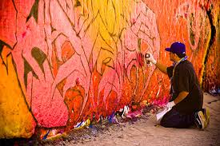
Graffiti artists are not criminals!
Summarise 5 points you want to make
Notes:
October 2017. Kindly contributed to www.skillsworkshop.org by Sean Delaney

Slide 3
Taking time to plan
Introduction. Shock tactic.
What is the most shocking fact we discovered about graffiti and crime?
Notes:
October 2017. Kindly contributed to www.skillsworkshop.org by Sean Delaney

Slide 4
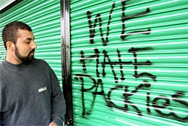
Second paragraph – next point.
Use some empathy. Explain why some graffiti cannot be considered art.
However, not all graffiti can be considered art. For example….
Notes:
October 2017. Kindly contributed to www.skillsworkshop.org by Sean Delaney

Slide 5
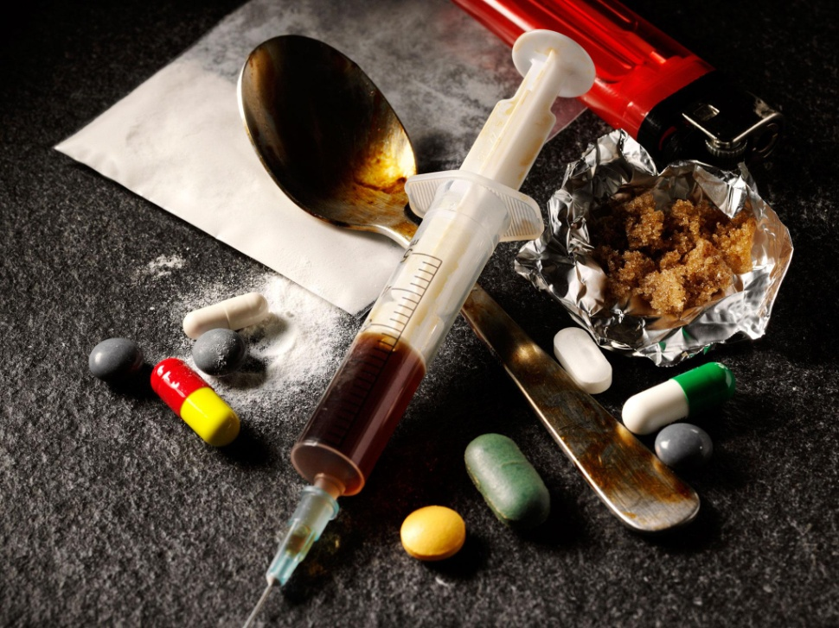
Crime and graffiti
Describe the scientific research and the link between graffiti and other crime.
Furthermore, some research shows that …..
Notes:
October 2017. Kindly contributed to www.skillsworkshop.org by Sean Delaney

Slide 6
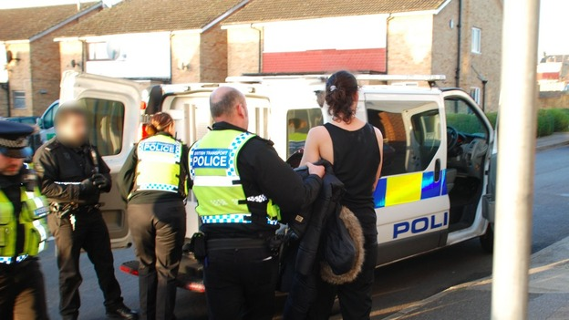
The injustice of treating graffiti artists like criminals
Describe what happened to some of the graffiti artists, and why it is wrong the way they were treated.
Key words:
Entrapment
Injustice
Notes:
October 2017. Kindly contributed to www.skillsworkshop.org by Sean Delaney

Slide 7
Summary
Final paragraph.
Sum up what you have said.
Restate your point of view.
Check – punctuation, spelling
& grammar
Have you used any imagery? (Metaphors)
Notes:
October 2017. Kindly contributed to www.skillsworkshop.org by Sean Delaney

