Slide 1
USING DISTANCE DIAGRAMS and MILEAGE CHARTS
September 2017. Kindly contributed by Nicola Smith, Gloucestershire College. Search for Nicky on www.skillsworkshop.org
Please refer to the download page for this resource on skillsworkshop for detailed curriculum links and related resources.
Ensure that you run this PPT as a full screen slideshow or you will miss the useful animated help and pop up solutions.
Functional Mathematics Curriculum links
E3: Understand, estimate, measure & compare length, capacity, weight, temperature.
Complete simple calculations involving money and measures.
Extract, use and compare information from lists, tables, simple charts/graphs
L1: Solve problems requiring calculation, with common measures, inc. money, time, length, weight, capacity and temperature.
Extract and interpret information from tables, diagrams, charts and graphs.
Notes:
September 2017. Kindly contributed to www.skillsworkshop.org by Nicola Smith, Gloucestershire College.

Slide 2
Mileage Charts
Aim:
To recognise and use a mileage chart
Objectives:
* To calculate the distance between various places using a mileage chart.
* Design and complete a chart to display mileage between different places.
Notes:
September 2017. Kindly contributed to www.skillsworkshop.org by Nicola Smith, Gloucestershire College.

Slide 3
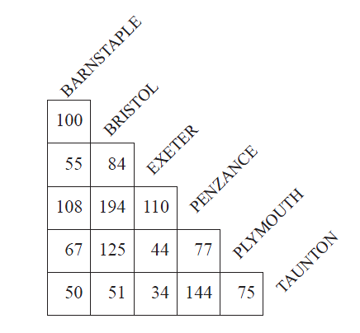
Mileage Chart
Distances in the table below are given in miles.
How do we use it?
Notes:
September 2017. Kindly contributed to www.skillsworkshop.org by Nicola Smith, Gloucestershire College.

Slide 4
(a) How far is it from Bristol to Plymouth?
Notes:
September 2017. Kindly contributed to www.skillsworkshop.org by Nicola Smith, Gloucestershire College.

Slide 5
Solution
(a) 125 miles
(a) How far is it from Bristol to Plymouth?
OK! Nice easy one to start with.
Notes:
September 2017. Kindly contributed to www.skillsworkshop.org by Nicola Smith, Gloucestershire College.

Slide 6
How far is it from Barnstable to Plymouth?
Notes:
September 2017. Kindly contributed to www.skillsworkshop.org by Nicola Smith, Gloucestershire College.

Slide 7
(b) Jerry travels from Barnstaple to Exeter, then from Exeter to Plymouth, and finally from Plymouth back to Barnstaple.
How far does he travel altogether?
Don't shout out the answer. Let everyone have a go.
Write it down and then we will see if you are right.
Notes:
September 2017. Kindly contributed to www.skillsworkshop.org by Nicola Smith, Gloucestershire College.

Slide 8
Solution
55
(b) Jerry travels from Barnstaple to Exeter, then from Exeter to Plymouth, and finally from Plymouth back to Barnstaple.
How far does he travel altogether?
Notes:
September 2017. Kindly contributed to www.skillsworkshop.org by Nicola Smith, Gloucestershire College.

Slide 9
Solution
55
+44
(b) Jerry travels from Barnstaple to Exeter, then from Exeter to Plymouth, and finally from Plymouth back to Barnstaple.
How far does he travel altogether?
Notes:
September 2017. Kindly contributed to www.skillsworkshop.org by Nicola Smith, Gloucestershire College.

Slide 10
Solution
55
+44
+67
=166
(b) Jerry travels from Barnstaple to Exeter, then from Exeter to Plymouth, and finally from Plymouth back to Barnstaple.
How far does he travel altogether?
Notes:
September 2017. Kindly contributed to www.skillsworkshop.org by Nicola Smith, Gloucestershire College.

Slide 11
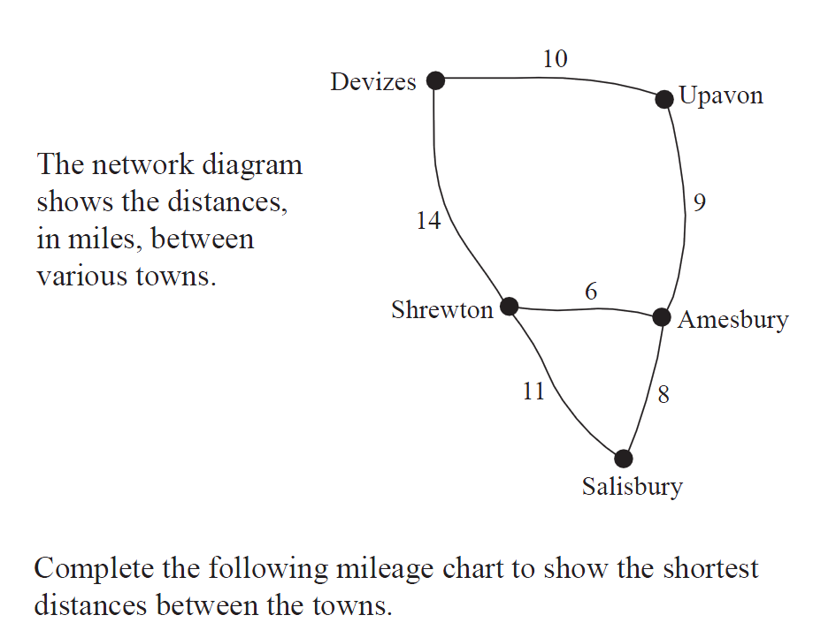
DISTANCE
DIAGRAMS
Notes:
September 2017. Kindly contributed to www.skillsworkshop.org by Nicola Smith, Gloucestershire College.

Slide 12
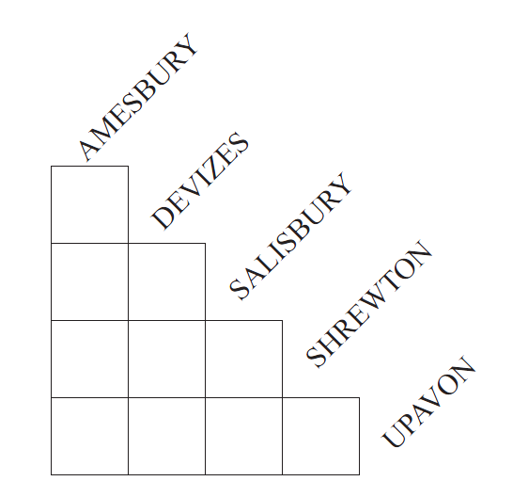
Copy the empty mileage chart and complete it.
Remember to use the shortest distance between the towns. E.g. For Devizes to Amesbury use 19 miles not 20.
Notes:
September 2017. Kindly contributed to www.skillsworkshop.org by Nicola Smith, Gloucestershire College.

Slide 13
19
8
25
6
14
11
How do we do each one?
9
10
17
15
Notes:
September 2017. Kindly contributed to www.skillsworkshop.org by Nicola Smith, Gloucestershire College.

Slide 14
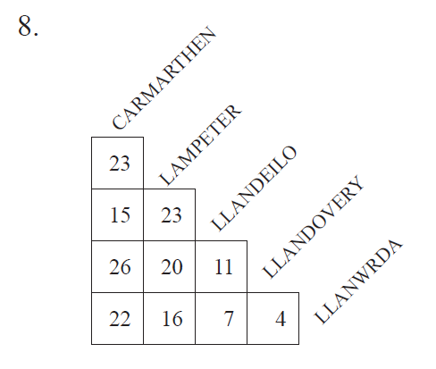
CHALLENGE QUESTION
You have to deliver the post to the following towns. Start at Carmarthen. Go to Llandovery, then on to Lampeter and then on to Llanwrda. From Llanwrda you go to Llandeilo and then back to Carmarthan. How many miles will you travel?
Notes:
September 2017. Kindly contributed to www.skillsworkshop.org by Nicola Smith, Gloucestershire College.

