Slide 1
Embedded Functional Skills English Remembrance Day poppies: speaking, listening & discussion
Nov 2022. Kindly contributed by Alex Morgan, Birmingham Adult Education Service.
Search for Alex on www.skillsworkshop.org
Please refer to the download page for this resource on skillsworkshop for detailed curriculum links and related resources https://www.skillsworkshop.org/resources/remembrance_day_poppies_and_british_values
For full use of hyperlinks and other features, this presentation should be run in full screen mode.
Covers many Reformed Functional Skills English content descriptors, including:
Speaking, listening and communication: E2.1 Identify and extract the main information and detail from short explanations E2.4 Follow the gist of discussions E2.5 Clearly express straightforward information and communicate feelings and opinions on a range of straightforward topics E2.6 Make appropriate contributions to simple group discussions with others about a straightforward topic | E3.1 Identify and extract relevant information and detail in straightforward explanations E3.3 Communicate information and opinions clearly on a range of topics E3.5 Follow and understand the main points of discussions E3.6 Make relevant contributions to group discussions about straightforward topics E3.7 Listen to and respond appropriately to other points of view, respecting conventions of turn-taking | L1.1 Identify relevant information and lines of argument in explanations or presentations L1.4 Communicate information, ideas and opinions clearly and accurately on a range of topics L1.5 Express opinions and arguments and support them with evidence L1.6 Follow and understand discussions and make contributions relevant to the situation and the subject
Source: Subject content functional skills: English. DfE (Feb 2018), https://www.gov.uk/government/publications/functional-skills-subject-content-english
Notes:
November 2022. Kindly contributed to www.skillsworkshop.org by Alex Morgan.
1

Slide 2
Remembrance Day
Notes:
November 2022. Kindly contributed to www.skillsworkshop.org by Alex Morgan.

Slide 3
What are the four British Values?
Democracy
Rule of Law
Mutual Respect and Tolerance
Individual Liberty
Notes:
Highlight we will be using the last two in the discussions
November 2022. Kindly contributed to www.skillsworkshop.org by Alex Morgan.

Slide 4
What is Armistice Day?
The Armistice, an agreement to end the fighting of the First World War as a prelude to peace negotiations, began at 11am on 11 November 1918.
Armistice is Latin for to stand (still) arms.
To this day we mark Armistice Day around the United Kingdom with a Two Minute Silence at 11am on the 11th day of the 11th month.
Notes:
November 2022. Kindly contributed to www.skillsworkshop.org by Alex Morgan.

Slide 5
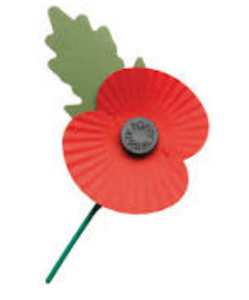
What is remembrance?
What does the poppy symbolise?
Remembrance honours those who serve to defend our democratic freedoms and way of life.
People wear poppies to honour and remember members of the Armed Forces in Britain and the Commonwealth who have died.
Notes:
November 2022. Kindly contributed to www.skillsworkshop.org by Alex Morgan.

Slide 6
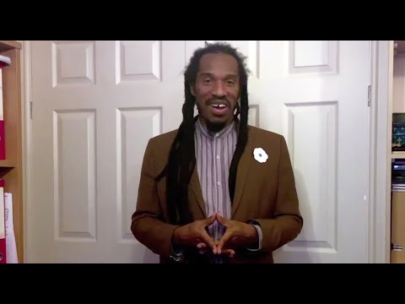
Does everyone wear a red poppy?
https://www.youtube.com/watch?v=jtjCGCxT_PU&t=110s
Notes:
November 2022. Kindly contributed to www.skillsworkshop.org by Alex Morgan.

Slide 7
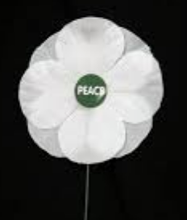
The white poppy
The white poppy was first made by the Co-operative Women's Guild in 1933.
It stands for:
Remembrance of all victims of war, both civilians and the armed forces
Challenging war and militarism
A commitment to peace
Notes:
November 2022. Kindly contributed to www.skillsworkshop.org by Alex Morgan.

Slide 8
The Black Poppy Rose
The Black Poppy Rose was created in 2010 to specifically remember the soldiers and peoples of African, Black, West Indian, Caribbean, Pacific Islands and Indigenous communities to wars.
Notes:
November 2022. Kindly contributed to www.skillsworkshop.org by Alex Morgan.

Slide 9
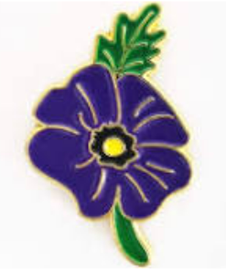
The purple poppy
The purple poppy remembers animals who have died in service. Many horses died in World War 1. Nowadays dogs are the most common service animal.

Slide 10
Should people wear a poppy?
This is a topic that people can have very strong feelings about. We will use the values of mutual respect and tolerance for different views, and individual liberty.
Notes:
November 2022. Kindly contributed to www.skillsworkshop.org by Alex Morgan.

