Slide 1
A-Z Job Words
Literacy Rw/E2.4 Use initial letters to find and sequence words in alphabetical order
Literacy (ESOL) Rw/E3.4 (a) Use first and second place letters to find and sequence words in alphabetical order
and for underpinning E2 Functional English
Kindly contributed to www.skillsworkshop.org by Gemma Holtam, West Yorkshire ESOL.
Search for Gemma on www.skillsworkshop. Related PDF worksheets are also available.
Notes:
Kindly contributed to www.skillsworkshop.org by Gemma Holtam, West Yorkshire ESOL.
Search for Gemma on www.skillsworkshop. Related PDF worksheets are also available.

Slide 2
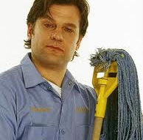
Caretaker
Notes:
Kindly contributed to www.skillsworkshop.org by Gemma Holtam, West Yorkshire ESOL.
Search for Gemma on www.skillsworkshop. Related PDF worksheets are also available.

Slide 3
Notes:
Kindly contributed to www.skillsworkshop.org by Gemma Holtam, West Yorkshire ESOL.
Search for Gemma on www.skillsworkshop. Related PDF worksheets are also available.

