Slide 1
E1-E3 Functional Skills English, ESOL, ICT Supermarket Sweep: embedded digital skills for ESOL & Functional English
February 2022. Kindly contributed by Sharon Roberts and Alexandra Bates, ACL Essex. Search for Alexandra on www.skillsworkshop.org
Please refer to the download page for this resource on skillsworkshop for detailed curriculum links and related resources including the PDF lesson plan https://www.skillsworkshop.org/resources/supermarket_sweep_embedded_digital_skills_for_esol_functional_english
For full use of hyperlinks and other features, this presentation should be run in full screen mode.
Covers many ESOL and Functional Skills English / ICT criteria, including:
ESOL - reading: Rw/E1.1a Recognise a limited number of words, signs and symbols Rw/E1.2a Use basic sound-letter correspondence to sound out words Rw/E2.2a Recognise a range of familiar words Rw/E2.3a Use context & range of phonic / graphic knowledge to decode words Rw/E3.1a Recognise and understand relevant specialist key words Rw/E3.5a Use variety of reading strategies to read/understand unfamiliar words Rt/E2.4a Obtain information from illustrations, maps, diagrams and captions Rt/E3.3a Identify the key organisational features of instructional texts Rt/E3.5a Locate organisational features, such as contents, index, menus Adult ESOL Core Curriculum (DfES, 2001) https://www.excellencegateway.org.uk/content/etf1194 | Functional Skills English - reading: E1.8 Read correctly words designated for Entry 1 E2.7 Read correctly words designated for Entry 2 E2.12 Use illustrations, images & captions to locate information E3.8 Read correctly words designated for Entry 3 E3.12 Understand organisational features & use them to locate relevant information Subject content [reformed] functional skills: English (DfE, Feb 2018) https://www.gov.uk/government/publications/functional-skills-subject-content-english | Functional Skills ICT: Using ICT – various criteria at E1-E3 Finding & Selecting Information – various criteria at E1-E3 Functional Skills Criteria for ICT (Ofqual, Sept 2011) https://www.gov.uk/government/publications/functional-skills-criteria-for-ict
Notes:
February 2022. Kindly contributed to www.skillsworkshop.org by Alexandra Bates, Essex ACL.
1

Slide 2
Name the logo
Notes:
February 2022. Kindly contributed to www.skillsworkshop.org by Alexandra Bates, Essex ACL.

Slide 3
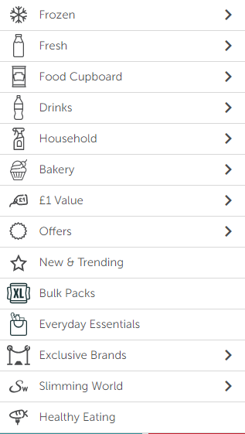
Activities:
1) Think:
Think of an item you might find in each category.
2) Write:
Complete your shopping list for the week. Which category might you find your items in? Use the table to help.
3) Shop:
Complete your shopping online using www.Iceland.co.uk
3) Share:
Talk to your neighbour. How much did you spend?
4) Extend:
Write a new shopping list for:
A children’s birthday party.
A budget of £50.
For someone who is vegan.
Extension: Verbally recall the steps required to complete the purchase and confirm the delivery. Do you need to create an account? Do they deliver to your area?
Notes:
February 2022. Kindly contributed to www.skillsworkshop.org by Alexandra Bates, Essex ACL.

Slide 4
Find items for the categories.
Frozen | Fresh | Food Cupboard | Drinks | Household | Bakery | £1 value | Bulk packs | Everyday essentials | Healthy living
Notes:
Print this for learners to make their shopping lists on. Or use as digital version.
February 2022. Kindly contributed to www.skillsworkshop.org by Alexandra Bates, Essex ACL.

