Slide 1
Skimming, Scanning, Reading for Detail, and Images in Text
February 2013. Kindly contributed by Heather Vickers, Leeds.
Search for Heather on www.skillsworkshop.org
Please visit the download page for this resource on skillsworkshop.org for links to related resources.
Underpins the following Functional English coverage & range statements
Entry Level 3
Understand the main points of texts
Obtain specific information through detailed reading
Use organisational features to locate information
Read / understand texts in different formats using strategies / techniques appropriate to task
Level 1
Identify the main points and ideas and how they are presented in a variety of texts
Read and understand texts in detail
http://www.ofqual.gov.uk/
Notes:
September 2013. Kindly contributed to www.skillsworkshop.org by Heather Vickers, Leeds.

Slide 2
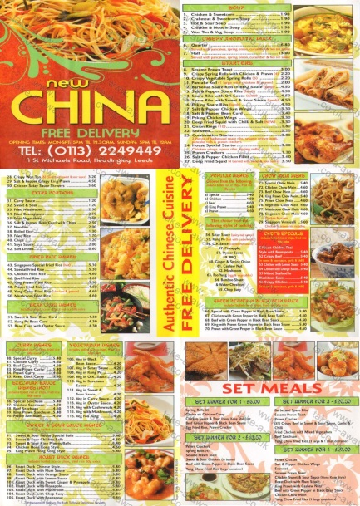
OCR Functional Skills: English E3
Skimming, Scanning, Reading for Detail and Images in Text.
Notes:
September 2013. Kindly contributed to www.skillsworkshop.org by Heather Vickers, Leeds.

Slide 3
Objectives
Skim read titles, headings and illustrations to decide if material is of interest.
Scan texts to locate information.
Obtain specific information through detailed reading.
Relate an image to print and use it to obtain meaning.
* Fill in your self-assessment form to show how you feel about these objectives now. *
Notes:
September 2013. Kindly contributed to www.skillsworkshop.org by Heather Vickers, Leeds.

Slide 4
Skimming and Scanning video
Useful techniques to help you read a text quickly.
Don’t have to read every word.
What’s the difference?
Notes:
September 2013. Kindly contributed to www.skillsworkshop.org by Heather Vickers, Leeds.

Slide 5
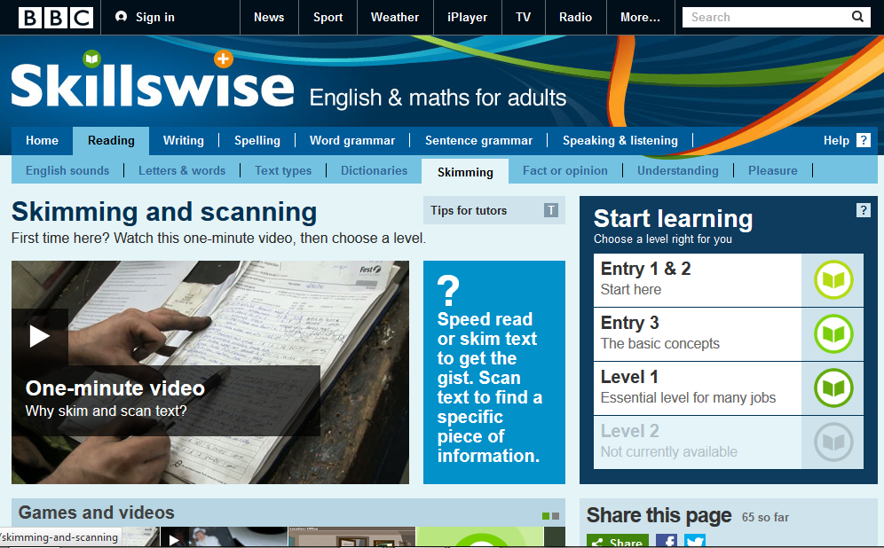
Skimming
Used to get the main ideas of a text quickly (the ‘gist’).
Look for titles, headings and illustrations of interest.
Can you think of any examples?
Notes:
September 2013. Kindly contributed to www.skillsworkshop.org by Heather Vickers, Leeds.
Newspapers, books, websites.

Slide 6
Scanning
Used to locate information quickly.
Want information about a specific topic.
Know the key words you are looking for.
Can you think of any examples?
Notes:
September 2013. Kindly contributed to www.skillsworkshop.org by Heather Vickers, Leeds.
TV Guide, Dictionary, Phone Book.

Slide 7
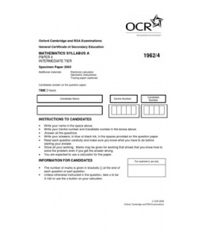
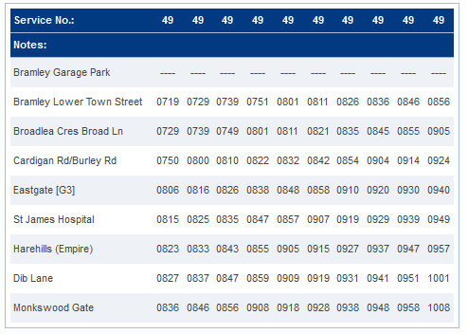
Reading for Detail
Sometimes you need to read every word.
Can you think of any examples?
Notes:
September 2013. Kindly contributed to www.skillsworkshop.org by Heather Vickers, Leeds.
Exam paper, Instructions, Bus Timetable.

Slide 8
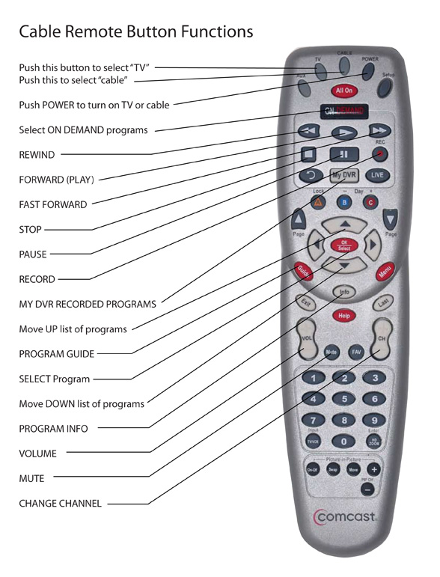
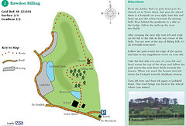
Images in Text
Often part of a text.
Get the point across quickly and easily.
Can you think of any examples?
Notes:
September 2013. Kindly contributed to www.skillsworkshop.org by Heather Vickers, Leeds.
Leaflet with map (Doorstep Walks Leeds), TV remote instructions, magazine cover to let you know what to expect.

Slide 9
Skim, Scan and Read for Detail
Skim to find a suitable text for finding the definitions of:
Scan the text to find the words.
Read for detail to find definitions of the words.
Write the definitions in your personal dictionary.
Discuss with your partner the reasons for your choice.
Notes:
September 2013. Kindly contributed to www.skillsworkshop.org by Heather Vickers, Leeds.

Slide 10
Objectives
Skim read titles, headings and illustrations to decide if material is of interest.
Scan texts to locate information.
Obtain specific information through detailed reading.
Relate an image to print and use it to obtain meaning.
* Fill in your Self-Assessment Form to show how you feel about these objectives now. *
Notes:
September 2013. Kindly contributed to www.skillsworkshop.org by Heather Vickers, Leeds.

