Slide 1
Entry & Level 1 Essential Digital Skills (EDS) with embedded Functional Skills English Unit 1: Using devices & handling information
June 2022. Kindly contributed by Stephanie Gilford, Birmingham Adult Education Service.
Search for Steph on www.skillsworkshop.org or go to on https://www.skillsworkshop.org/users/stephanie_gilford
Refer to the download page for this resource on skillsworkshop for detailed curriculum links & related resources https://www.skillsworkshop.org/resources/eds_unit_1_using_devices_handling_information_with_embedded_english_tasks
This PPT is one of a series. For full use of hyperlinks and other features, this presentation should be run in full screen mode. Please refer to the notes area of slides for source details, links, etc.
Covers many EDS & Functional Skills English standards, including:
EDS 1.1.1 Using devices 1.1.2 Finding and evaluating information 1.1.3 Managing and storing information 1.1.4 Identifying and solving technical problems Sources: https://www.gov.uk/government/publications/essential-digital-skills-framework https://www.gov.uk/government/publications/functional-skills-subject-content-english
SL&C: L1.1 (L2.1) Identify relevant information from (extended) explanations or presentations. L1.4 (L2.5) Communicate information, ideas and opinions clearly and accurately (effectively) on a range of topics Writing: L1.22 (L2.23) Communicate information, ideas and opinions clearly, coherently and accurately (effectively) L1.23 (L2.24) Write text of an appropriate level of detail and of appropriate length (including where this is specified) to meet the needs of purpose and audience | Reading: L1.13 Use reference materials and appropriate strategies for a range of purposes, including to find meaning of words L1.17 Read & understand a range of specialist words in context L2.11 Identify the different situations when the main points are sufficient and when it is important to have specific details L2.15 Use a range of reference materials and appropriate resources (e.g. glossaries, legends/keys) for different purposes, including to find the meanings of words in straightforward and complex sources
Notes:
June 2022: Kindly contributed to www.skillsworkshop.org by Stephanie Gilford, Birmingham Adult Education Service.
1

Slide 2
Unit one: Using Devices and Handling Information
Device usage bingo What devices do you use?
Computer/desktop | Phone | Laptop
Tablet | E-reader | AI assistant
Smart watch | Smart TV | Games consoles
Which of these do you use? What did you use them for?
Are there any others that you use that have not been included?
What are the problems with these devices? Look at each one carefully.
Where did you learn to use this device? What age were you when you learnt to use this device?
Are there any benefits to using so many devices?
How can we prevent these problems?
What should we be aware of when filling our lives with devices?
Make a list for both of these questions.
Make a list in your small groups.
Notes:
June 2022: Kindly contributed to www.skillsworkshop.org by Stephanie Gilford, Birmingham Adult Education Service.

Slide 3
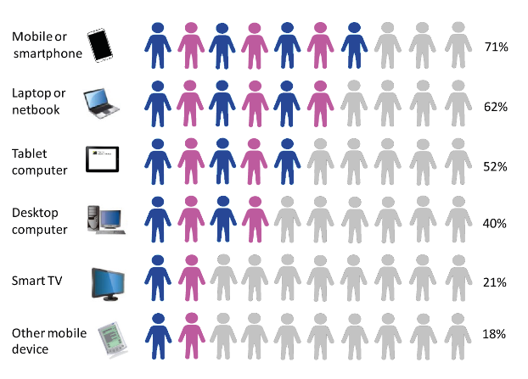
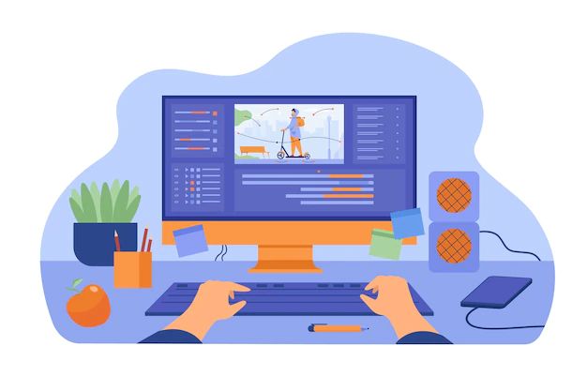
Unit one: Using Devices and Handling Information
In small groups, list pros and cons for each of these devices. How will these devices benefit and limit our lives? You could think about your personal experience and try to imagine for those devices that you have never used.
Think about each age group, too. What will be beneficial for one age group, may be a drawback for another.
Device | Pros | Cons
PC
Iphone
Android Phone
Tablet
Laptop
Smart Watch
E-reader
Smart TV
AI Assistant (Alexa, etc)
Games Consoles
This chart is from 2016. How do you think these statistics have changed since then?
Why is it important to use up-to-date sources?
Which is the most beneficial device?
Which is the most detrimental?
Why?
Notes:
June 2022: Kindly contributed to www.skillsworkshop.org by Stephanie Gilford, Birmingham Adult Education Service.

Slide 4
Unit one: Using Devices and Handling Information
A question for you…
On both phones, and computers: How do you change and apply system settings? What accessibility settings might we need if you are: Blind or partially sighted Dyslexic Deaf or hard of hearing
While exploring Essential Digital Skills, there will be lots of vocabulary for you to learn and remember. In your notes, create a glossary of any new words that you come across.
Creating your own glossary Which key terms do you understand without looking them up?
Key word | Definition | Example
Hardware
Software
Operating System
Application
Accessibility
How many of these words can you use in a paragraph about your own use of IT correctly?
What applications do you use and what for? How do they make your life easier?
Something to think about…
Why is it important that we have accessibility settings? Write a short paragraph to explain.
Think about the Equality Act (2010).
A question for you…
On both phones, and computers: How do you locate and install an application? Can you think of any examples that you use often?
Notes:
June 2022: Kindly contributed to www.skillsworkshop.org by Stephanie Gilford, Birmingham Adult Education Service.

Slide 5
Unit one: Using Devices and Handling Information
Creating your own glossary Which key terms do you understand without looking them up?
Key word | Definition/picture of each item | Intended use
Monitor
Mouse
Keyboard
Motherboard
CPU
RAM
Complete the worksheet pictured below:
Label each image with the correct name.
Use the glossary table above to help you.
Are there other examples of hardware that you can think of? Why do we use these other examples?
Notes:
June 2022: Kindly contributed to www.skillsworkshop.org by Stephanie Gilford, Birmingham Adult Education Service.

Slide 6
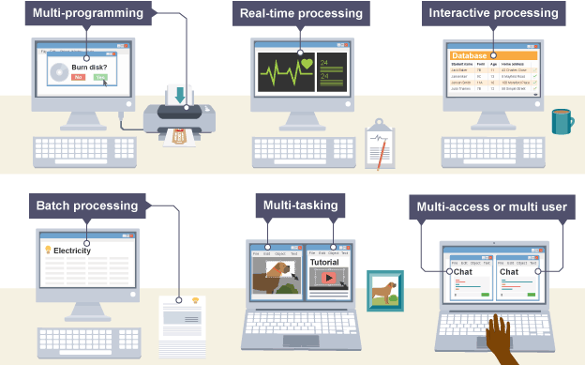
Unit one: Using Devices and Handling Information
Question: What does the phrase ‘operating system’ mean to you?
An operating system is the most important software that runs on a computer. It manages the computer's memory and processes, as well as its software and hardware. It also allows you to communicate with the computer without knowing how to speak the computer's language.
Find out what operating system your device uses on the next slide!
Next slide…
Notes:
June 2022: Kindly contributed to www.skillsworkshop.org by Stephanie Gilford, Birmingham Adult Education Service.

Slide 7
Unit one: Using Devices and Handling Information
Ways to check what OS you are using.
1. To find out which Android OS is on your device:
Open your device's Settings.
Tap About Phone or About Device.
Tap Android Version to display your version information.
2. To find out which OS is on your Apple phone.
Go to your iPad or iPhone's home screen, then touch the "Settings" icon. From there, select "General." Next, tap "About." You'll see all of the information about your device, including the version of your iOS device.
3. To find out which is on your Mac.
From the Apple menu  in the corner of your screen, choose About This Mac. You should see the macOS name, such as macOS Mojave, followed by its version number.
4. To find out which OS is on your PC.
Select the Start button, type Computer in the search box, right-click on Computer, and then select Properties. Under Windows edition, you'll see the version and edition of Windows that your device is running.
Questions to think about:
Are there any problems with your device?
If there are problems with your device, how do you fix it?
How can we set up parental controls on devices for children? Why do we set parental controls?
Notes:
June 2022: Kindly contributed to www.skillsworkshop.org by Stephanie Gilford, Birmingham Adult Education Service.

Slide 8
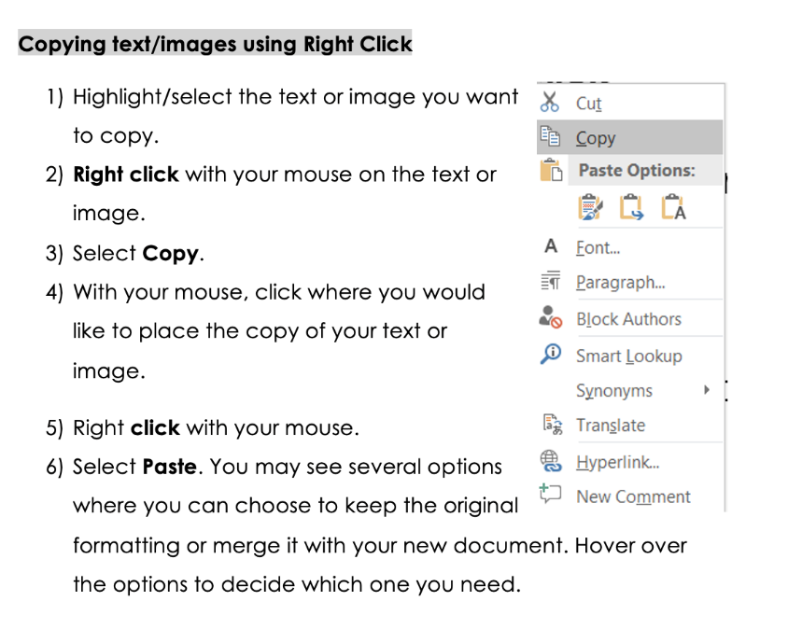
Unit one: Using Devices and Handling Information
Quick tip!
You could copy and paste some of the examples you find.
To copy and paste, you would need to follow the instructions below.
Add to your glossary! Which key terms do you understand without looking them up?
Key word | Definition | Example
Website
Hyperlink
Bookmarks
URL
Web browser
Media
Navigation controls
Think, pair, share!
Start by thinking these words through independently for 3-4 minutes. Then, share with the person you’re sitting next to and fill in any blanks.
Then, share with another pair on your table.
Notes:
June 2022: Kindly contributed to www.skillsworkshop.org by Stephanie Gilford, Birmingham Adult Education Service.

Slide 9
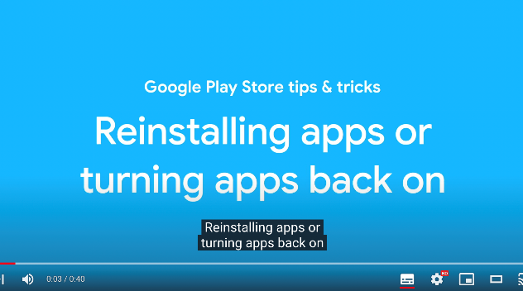
Unit one: Using Devices and Handling Information
Video one: What is an application?
Video two: Android apps
Video three: Windows 10 apps
Have you heard of any of the apps in the video?
Which three apps do you use most often?
What would you like to know about apps?
Have a go at installing an app that is recommended by your teacher to aid your learning.
Notes:
Video one link: https://www.youtube.com/watch?v=naci56mJ9F0
Video two link: https://www.youtube.com/watch?v=tb5nBf-NjOQ&t=1s
Video three link: https://www.youtube.com/watch?v=qvS15-8EqmE&t=2s
Suggested apps for learners to download: quizziz, Jamboard, kahoot, wordwall, etc
June 2022: Kindly contributed to www.skillsworkshop.org by Stephanie Gilford, Birmingham Adult Education Service.

Slide 10
Unit one: Using Devices and Handling Information
What do each of these logos represent? In each box, can you write the name of the website or application?
Which of these apps have you used?
What did you think of them?
Stretch and challenge:
What do you use these applications or websites for?
What are the pros and cons of each?
How can each of these applications help you study English?
Notes:
June 2022: Kindly contributed to www.skillsworkshop.org by Stephanie Gilford, Birmingham Adult Education Service.

Slide 11
Unit one: Using Devices and Handling Information
Part 2: What do each of these logos represent? In each box, can you write the name of the website or application?
Which of these apps have you used?
What did you think of them?
Stretch and challenge:
What do you use these applications or websites for?
What are the pros and cons of each?
How can each of these applications help you study English?
Notes:
June 2022: Kindly contributed to www.skillsworkshop.org by Stephanie Gilford, Birmingham Adult Education Service.

Slide 12
Unit one: Using Devices and Handling Information
Writing task
We’ve examined apps and what they’re used for, and how they benefit our lives.
Now, write a short review of your most used, or favourite app from the ones we’ve looked at.
In your review, you should:
Explain what the app is used for.
Describe how well the app fulfils its purpose – does it do what it is meant to do?
Suggest any improvements that could be made to the app in the future.
Your review should be 5 paragraphs long.
Before we start writing:
What keywords could we use in our review?
Review your understanding of complex sentences to ensure your writing is of a good standard.
Without using the internet, how many words can you list that are synonyms for ‘good’?
Try the same with the word ‘bad’.
Stretch and challenge: put them in order of how strong they are.
Notes:
June 2022: Kindly contributed to www.skillsworkshop.org by Stephanie Gilford, Birmingham Adult Education Service.

Slide 13
Unit one: Using Devices and Handling Information
Finding the right information on the internet can be a tricky task. A search engine can help to locate information quickly and accurately. Can you name some different search engines?
When searching for information on the internet it is important to think carefully about the words you use. The words you choose are called keywords.
Can you list three examples of search engines?
Which is the most popular search engine?
Look at the research questions below and underline three or four key words that would help to find the most relevant information. Write the key words in the box underneath.
Stretch and challenge:
How do we know which sources to use?
What makes a reliable source?
Which punctuation mark do we use to quote something we’ve found on the internet?
Why can’t we copy down what someone has said without crediting them?
Your task…
Research questions…
What is the biggest environmental problem in the world this year?
What inequalities do women still face in comparison to men?
Which career is the most popular this year?
Notes:
June 2022: Kindly contributed to www.skillsworkshop.org by Stephanie Gilford, Birmingham Adult Education Service.

Slide 14
Unit one: Using Devices and Handling Information
Storing data, keeping memories…
Older generations know that their memories can be found in photo albums or slides. These folks may have made home movies on a reel to reel, VHS tapes and possibly even a DVD. Even cavemen knew that storage is vital for remembering. Hence, we find their carvings on walls all over the world. People want to preserve their experiences this way.
In the sentence below, replace the highlighted word with a synonym that keeps the meaning of the sentence the same.
Even cavemen knew that storage is vital for remembering.
What do we mean when we talk about ‘cloud storage’?
File Size Basics
Kilobyte (KB): 1000 bytes = 1 KB. A short email (text only) = 5 KB. A five-page paper = 100 KB. ...
Megabyte (MB): 1000 KB = 1 MB. The average size of a webpage = 2 MB. ...
Gigabyte (GB): 1000 MB = 1 GB. 256 MP3 files = 1 GB. ...
Terabyte (TB): 1000 GB = 1 TB. 1,000 copies of the Encyclopedia Britannica = 1 TB.
Questions for you…
How do we store data on a computer?
Why do we need more than one method?
Why do we save and preserve so much?
How do you store data on your devices?
Notes:
https://www.myamberlife.com/learn/top-ways-to-store-your-digital-files/
June 2022: Kindly contributed to www.skillsworkshop.org by Stephanie Gilford, Birmingham Adult Education Service.

Slide 15
Unit one: Using Devices and Handling Information
What do you already know?
Have you ever used cloud storage?
Which of the below examples have you used in the past? Do you use any of them now?
How do you access cloud storage on your phone?
How can you access cloud storage on your computer?
In your groups, make a list of the pros and cons of using cloud storage.
Is it a good idea? Why/why not?
Pros | Cons
Notes:
June 2022: Kindly contributed to www.skillsworkshop.org by Stephanie Gilford, Birmingham Adult Education Service.

Slide 16
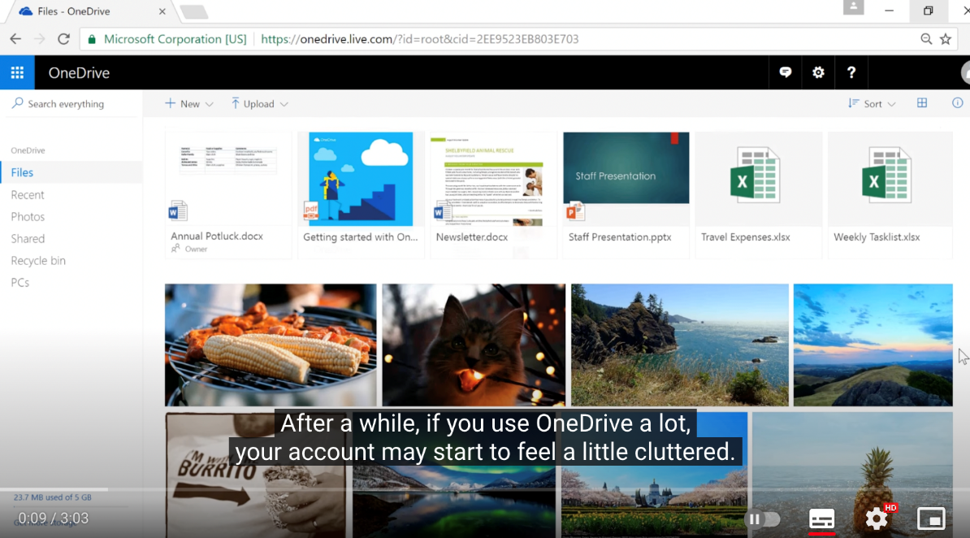
Unit one: Using Devices and Handling Information
Pre-task:
Before watching the video, look at the screenshot on the left. How could we make a ’cluttered’ folder more organised?
Task 1:
Watch the video and make notes on the key points. Then, answer the questions below:
Which features can help you to navigate your Onedrive easily?
How can you change the view from ‘Tiles view’?
Which function can you use to find a specific piece of work?
What could you type in to find a piece of work based on your first Ascentis module?
Without using a thesaurus, can you think of three synonyms that could be used to replace the word ‘cluttered’?
If these instructions were included in a guide for One Drive, which organisational features could you use to lay out the instructions?
Notes:
Video link: https://www.youtube.com/watch?v=l2aKGdJEJqE
Before watching the video, look at the screenshot on the left. How could we make a ’cluttered’ folder more organised?
Answer- subfolders, and file names
Viewing by list rather than icons also helps.
June 2022: Kindly contributed to www.skillsworkshop.org by Stephanie Gilford, Birmingham Adult Education Service.

Slide 17
Unit one: Using Devices and Handling Information
Taking a Screenshot: your tasks…
https://edu.gcfglobal.org/en/techsavvy/taking-screenshots/1/
Use the above webpage to read about taking a screenshot and then answer the following questions and complete the following tasks.
What is a screenshot?
Why might we take a screenshot? What are the benefits?
What must we remember to do after taking a screenshot?
What is the keyboard shortcut on a windows computer for taking a screenshot?
How can you take a screenshot on your phone?
Now, find a webpage about something that interests you. It could be a hobby, interest, or career you’re interested in. Find a reliable page and take a screenshot of a piece of information.
Add the screenshot to your ‘English’ folder, and a subfolder named with today’s date.
Change the name of your screenshot to ‘sample screenshot 1’.
Send that sample screenshot to your teacher via email.
Notes:
June 2022: Kindly contributed to www.skillsworkshop.org by Stephanie Gilford, Birmingham Adult Education Service.

Slide 18
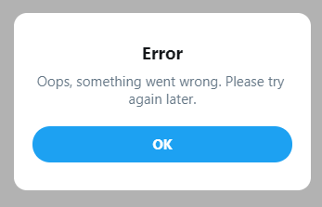
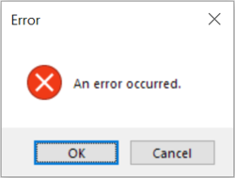
Unit one: Using Devices and Handling Information
Questions for you…
What does the phrase ‘error message’ mean to you?
What kind of error messages have you got when using your phone, or a computer?
What do you do when you get an error message normally?
What does the word ‘Troubleshooting’ mean to you?
Basic tips:
Write down your steps: Once you start troubleshooting, you may want to write down each step you take. This way, you'll be able to remember exactly what you've done and can avoid repeating the same mistakes. If you end up asking other people for help, it will be much easier if they know exactly what you've tried already.
Take notes about error messages: If your computer gives you an error message, be sure to write down as much information as possible. You may be able to use this information later to find out if other people are having the same error.
Always check the cables: If you're having trouble with a specific piece of computer hardware, such as your monitor or keyboard, an easy first step is to check all related cables to make sure they're properly connected.
Notes:
https://edu.gcfglobal.org/en/computerbasics/basic-troubleshooting-techniques/1/
June 2022: Kindly contributed to www.skillsworkshop.org by Stephanie Gilford, Birmingham Adult Education Service.

Slide 19
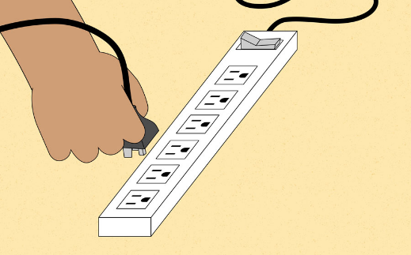
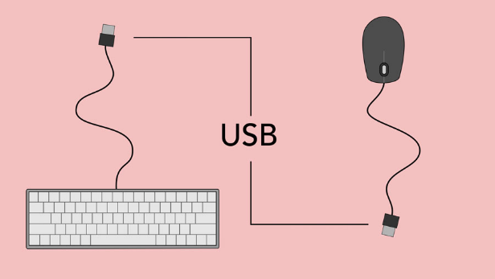
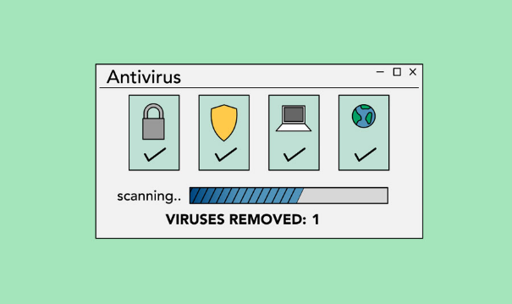
Unit one: Using Devices and Handling Information
Your task…
https://edu.gcfglobal.org/en/computerbasics/basic-troubleshooting-techniques/1/
Visit the link, read the article and summarise the main points in one paragraph.
Select five keywords from the article.
Now answer the questions on the right-hand side.
After reading…
What is the solution when an application is ‘frozen’?
What does ‘malware’ mean?
What is the solution if the computer is ‘frozen’?
Where can you find solutions if the generic ones don’t work?
Read the below paragraph and replace the word highlighted to keep the meaning of the paragraph the same:
Let's say you're trying to print out invitations for a birthday party, but the printer won't print. You have some ideas about what could be causing this, so you go through them one by one to see if you can eliminate any possible causes.
Notes:
June 2022: Kindly contributed to www.skillsworkshop.org by Stephanie Gilford, Birmingham Adult Education Service.

Slide 20
Unit one: Using Devices and Handling Information
Quiz:
What type of storage system is One Drive?
Can you list two different types of software, and two different types of hardware?
Can you think of two synonyms that could replace ‘good’ and two that could replace ’bad’?
What other ways are there to store data? List two alternatives to One Drive.
Define ‘hyperlink’.
Can you explain how you take a screenshot on a Windows Computer?
What is a pro of using a tablet?
What operating system does your phone use?
How many correct answers did you get?
What are your areas for development?
Notes:
June 2022: Kindly contributed to www.skillsworkshop.org by Stephanie Gilford, Birmingham Adult Education Service.

