Slide 1
New Year resolutions
This PPT accompanies a PDF reading comprehension exercise but can also be used alone as a discussion or writing prompt.
Suitable for E2-L1 Adult Literacy and ESOL
Kindly contributed to www.skillsworkshop.org by Shellyanne Graham,
Search for Shellyanne on www.skillsworkshop. Related PDF resources are also available.
Notes:
Kindly contributed to www.skillsworkshop.org by Shellyanne Graham,
Search for Shellyanne on www.skillsworkshop. Related PDF resources are also available.

Slide 2
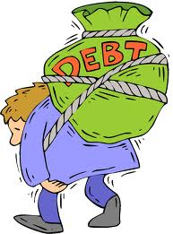
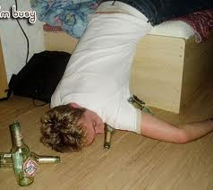
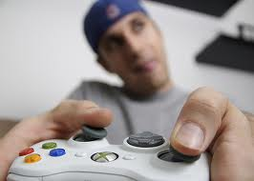
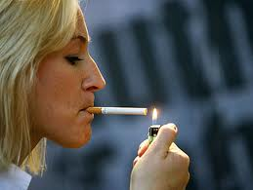
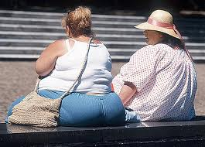
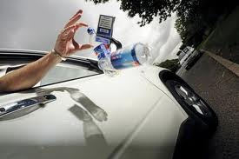
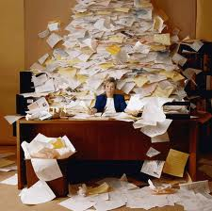
Suggest some New Year Resolutions for the people in these pictures. Give reasons.
Notes:
Kindly contributed to www.skillsworkshop.org by Shellyanne Graham,
Search for Shellyanne on www.skillsworkshop. Related PDF resources are also available.

