Slide 1

Functional English writing prompts
April 2012.
Kindly contributed by Carrie Bray, Leeds City College.
Search for Carrie on www.skillsworkshop.org and visit the download page for this resource to find further links and related resources.
Functional English Curriculum links
E2 Write short texts with some awareness of the intended audience
E3 Write texts with some adaptation to the intended audience
L1Use language, format and structure suitable for purpose and audience
L2 Use a range of writing styles for different purposes
Also covers many adult literacy elements.
Notes:
April 2012. Kindly contributed to www.skillsworkshop.org by Carrie Bray

Slide 2
Writing Exercises
Functional Skills
Notes:
April 2012. Kindly contributed to www.skillsworkshop.org by Carrie Bray

Slide 3
Writing Tips:
Think about punctuation. Use capital letters at the start of a sentence and a full stop at the end.
Use capitals for names of people, places, companies, etc, for “I”, and abbreviations such as RSPCA.
Use conjunctions, such as “and”, “but”, “because”.
Plan your work and think about what you are going to write.
Check your work for mistakes when you have finished.
Notes:
April 2012. Kindly contributed to www.skillsworkshop.org by Carrie Bray

Slide 4

If I could be anywhere else right now....
Where would you be?
What would you be doing?
Why do you like this place so much?
Notes:
April 2012. Kindly contributed to www.skillsworkshop.org by Carrie Bray

Slide 5
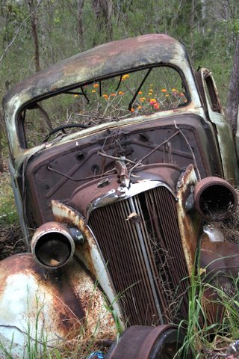
The car I would like to have...
If you could have any car, what would you have?
Why do you want this particular car?
Notes:
April 2012. Kindly contributed to www.skillsworkshop.org by Carrie Bray

Slide 6
If you could change one law, what would it be?
What would you change?
What would the impact be?
What would the advantages and disadvantages be?
Notes:
April 2012. Kindly contributed to www.skillsworkshop.org by Carrie Bray

Slide 7
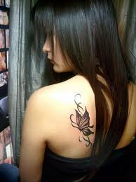
Would you ever have a tattoo?
What would you have? Where?
Are there any downsides?
Do you already have one?
Notes:
April 2012. Kindly contributed to www.skillsworkshop.org by Carrie Bray

Slide 8
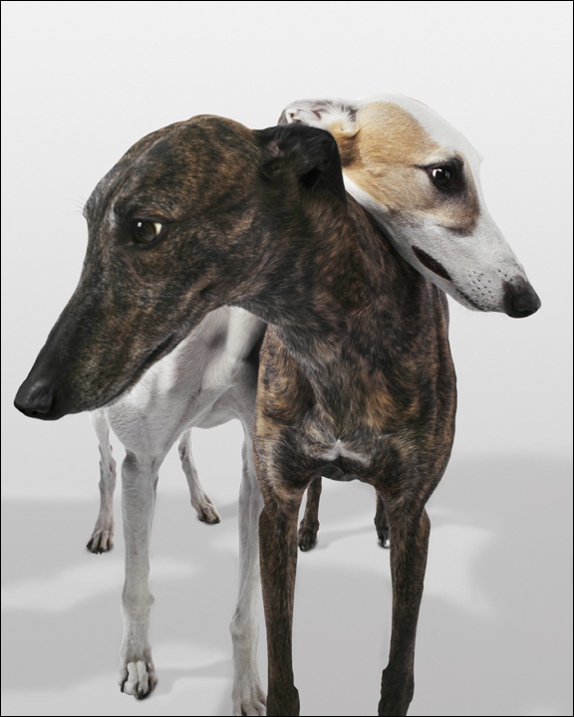
What pet would you most like?
What kind of pet would you have?
What sort of care would it need?
Notes:
April 2012. Kindly contributed to www.skillsworkshop.org by Carrie Bray

Slide 9

Should smoking be illegal?
Smoking is now banned in so many places and the age at which you can buy cigarettes was increased to 18. Is it time to just make it illegal? What do you think?
Notes:
April 2012. Kindly contributed to www.skillsworkshop.org by Carrie Bray

Slide 10

What does Northampton need?
Is there enough for young people to do?
Are there any shops you would like to see here?
Notes:
April 2012. Kindly contributed to www.skillsworkshop.org by Carrie Bray

Slide 11
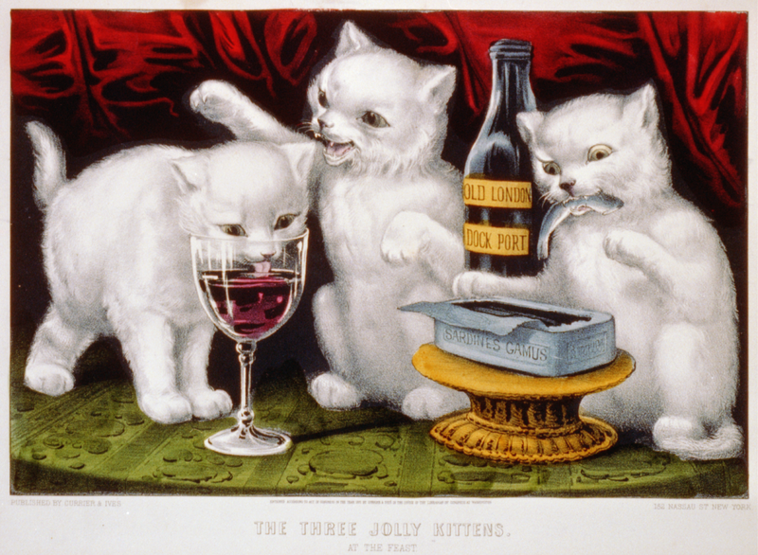
Is binge drinking really a problem?
Is binge drinking a problem, or are the media making a fuss and giving young people a bad name?
Notes:
April 2012. Kindly contributed to www.skillsworkshop.org by Carrie Bray

Slide 12
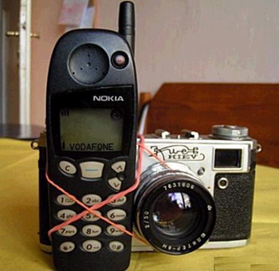
Mobile phones: important for safety or just a security blanket?
Do you use your phone because you have to, or are you afraid you might seem unpopular if it doesn’t ring constantly?
Notes:
April 2012. Kindly contributed to www.skillsworkshop.org by Carrie Bray

Slide 13
Is Christmas too commercial?
Is Christmas all about spending money, or spending time with family?
If you don’t celebrate Christmas, what do you do at this time of year?
Do you celebrate another festival? Is that getting too commercial?
Notes:
April 2012. Kindly contributed to www.skillsworkshop.org by Carrie Bray

