Slide 1
L1-2 Functional Skills English What’s in a name? Ice breaker for Functional English
January 2022. Kindly contributed by Stephanie Gilford, Birmingham Adult Education Service.
Search for Stephanie on www.skillsworkshop.org
Please refer to the download page for this resource on skillsworkshop for detailed curriculum links and related resources https://www.skillsworkshop.org/resources/whats_in_a_name_icebreaker_for_functional_english
For full use of hyperlinks, videos and other features, this presentation should be run in full screen mode.
Covers many Reformed Functional Skills English content descriptors, including:
Speaking, listening and communication: L1.4 Communicate information, ideas and opinions clearly and accurately on a range of topics L2.5 Communicate information, ideas and opinions clearly and effectively, providing further detail and development if required | Reading: L1.13 Use reference materials and appropriate strategies (e.g. using knowledge of different word types) for a range of purposes, including to find the meaning of words L1.17 Read and understand a range of specialist words in context L1.18 Use knowledge of punctuation to aid understanding of straightforward texts. | Writing: L1.22 [L2.23] Communicate information, ideas and opinions clearly, coherently and accurately
Notes:
January 2022. Kindly contributed to www.skillsworkshop.org by Stephanie Gilford, Birmingham Adult Education Service.
1

Slide 2
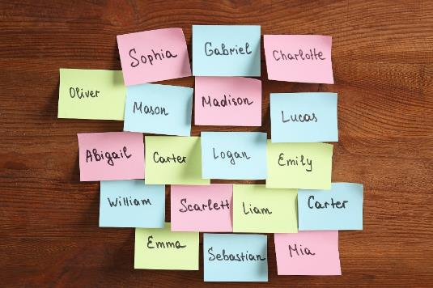
What’s in a name?
What’s in a name?
Our names are an incredibly important part of our identity. They carry deep personal, cultural, familial, and historical connections. They also give us a sense of who we are, the communities in which we belong, and our place in the world. This is why mispronunciations, misuse of our preferred/common names, or misgendering can negatively affect and possibly hurt and impact a sense of belonging.
Key Vocabulary | Definition
mispronunciations
misgendering
undeniable
microaggressions
How are commas used in the following sentence? ‘put in the difficult position of approaching, correcting, and calling in folks’
What type of word is this?
Incredibly Think about the suffix of the word…
Research task: what does your name mean? Where does it originate? Where do we get inspiration for our names?
The undeniable truth, however, is that these things will happen. Many times individuals whose names and pronouns are used in the wrong manner are put in the difficult position of approaching, correcting, and calling in folks. Instances of mispronunciation and misuse of preferred names and pronouns can be experienced as microaggressions. (ouch!)
Text source: https://students.ubc.ca/sites/students.ubc.ca/files/Importance_of_Names_Guide_v2.pdf
Notes:
January 2022. Kindly contributed to www.skillsworkshop.org by Stephanie Gilford, Birmingham Adult Education Service.

Slide 3
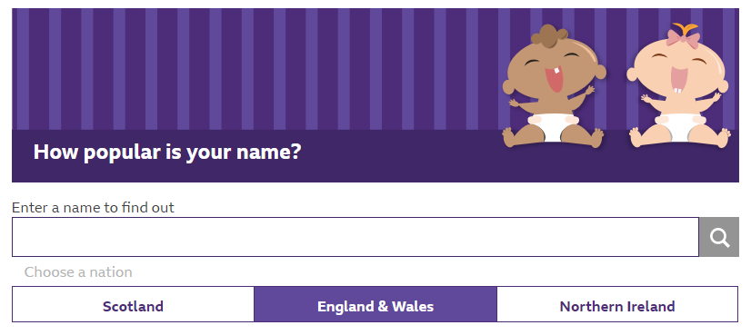
https://www.bbc.co.uk/news/uk-scotland-51673123
Open the link above. What’s the most popular name in the 1980s?
Discussion point…
Why do you think we shorten names? Can we use nicknames? Are nicknames okay?
Fun fact!
The German poet Christian Morgenstern once said that “all seagulls look as though their name were Emma.”
Discussion point…
Why is it important that we get to know each others' names and pronounce them correctly?
Watch the video…
What does Hena say about her experience of having her name mispronounced? Have you had a similar experience? How did it make you feel?
Check the popularity of your own name in Scotland, England & Wales and Northern Ireland. Where is your name the most popular?
What organisational feature is used to display the information?
Notes:
January 2022. Kindly contributed to www.skillsworkshop.org by Stephanie Gilford, Birmingham Adult Education Service.

Slide 4
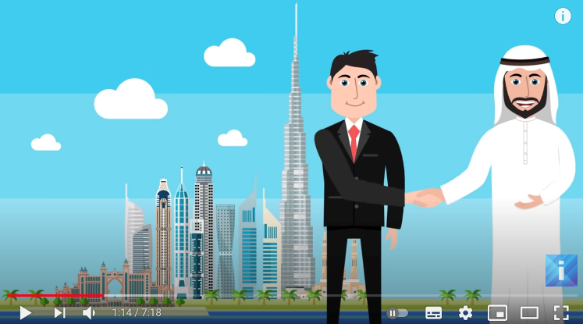
Naming traditions…
You will often see the same names used over and over again in families. While certain names are popular in different areas in different times in history, the repetition could represent a pattern. Many cultures believe in honouring their elders and do so by naming children after them. Angus Baxter in "In Search of Your British and Irish Roots" describes a pattern that was popular in England in the 1700-1875 period: The first son was named after the father's father The second son was named after the mother's father The third son was named after the father The fourth son was named after the father's eldest brother The first daughter after the mother's mother The second daughter after the father's mother The third daughter after the mother The fourth daughter after the mother's eldest sister
Check your sentence structure…
What kind of sentence is this? While certain names are popular in different areas in different times in history, the repetition could represent a pattern.
If you didn’t choose your children's name this way, what would they be if you had?
What do you look for in a name?
What punctuation marks can you spot on this slide?
Discussion point… Do we go through the same process of naming now?
Watch the video about the history of names across the world.
Text source: https://www.genealogy.com/articles/research/35_donna.html
Notes:
January 2022. Kindly contributed to www.skillsworkshop.org by Stephanie Gilford, Birmingham Adult Education Service.

Slide 5
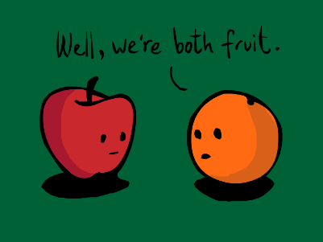
Naming traditions in other cultures…
Russian names have three parts: a given name, a patronymic (a middle name based on the father’s first name), and the father’s surname. If Viktor Aleksandrovich Rakhmaninov has two children, his daughter’s name would be Svetlana Viktorevna Rakhmaninova. (The “a” at the end of all three names shows that she is female.) Her brother would be Mikhail Viktorevich Rakhmaninov. Afghan names traditionally consist of only a first name. Last names are often chosen, when needed, using tribal affiliation, place of birth, profession, or honorific titles. This may result in people within the same family having different last names. Male given names are compound or double names and often include an Islamic or Arabic component such as Ahmad or Mohammad, and women are generally given Persian or Pashto names. Chinese names are made up of three characters: a one-character family name followed by a two-character given name. The child’s official name is used for the birth certificate and for school. Chinese children often have a different name that is used among friends, schoolmates, and colleagues.
Check your sentence structure…
Using what you know now about British naming traditions, pick a naming tradition from another country. You don’t have to use the ones I’ve chosen here, you can use the link at the bottom, or the internet, to select your own. Note down the similarities and differences between the British traditions, and the country you have chosen. Are there any similarities?
British traditions | Similarities | Naming tradition from a different country
Text source: http://blog.tesol.org/7-naming-customs-from-around-the-world/
Notes:
January 2022. Kindly contributed to www.skillsworkshop.org by Stephanie Gilford, Birmingham Adult Education Service.

Slide 6
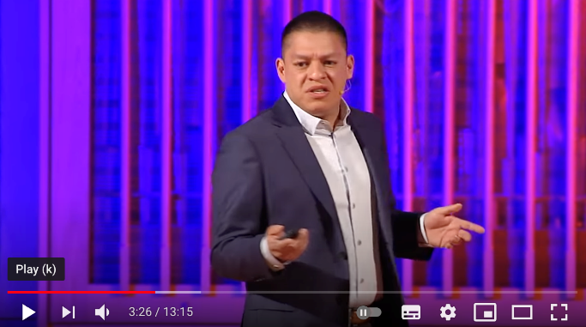
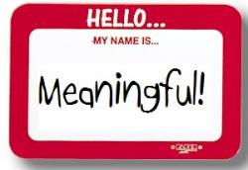
Know My Name…
After a long day at work, I came home and turned on an episode of The View, and Elaine Welteroth, former Teen Vogue Editor-in-Chief, was the special guest. During her interview, she mentioned her annoyance when being misidentified with other black women throughout her career, even while holding prominent positions, and even when they looked nothing alike. I gasped and hit rewind. I related so deeply because I could easily recount my own similar experiences. The most hurtful microaggressions concerned my name. As silly as it sounds, I didn’t realise how important my name was to my identity until people struggled to learn it or misidentified me as another black girl at work or school.
Watch the video…
Why did Geradro change his name? What reasons does he give? What can we do to make sure people feel valued and respected?
Mini writing task…
How important are names for you? Why is it important that we use the correct names? Add a paragraph to the leaflet you are putting together on equality.
Key Vocabulary | Definition
misidentified
Prominent
identity
Are there any words you are unsure of on this slide?
“Even when people are well-intentioned and kind, it’s still hurtful. Misidentification makes me feel invisible.”
Why are names important for achieving equality?
Is the process for naming our pets different? How do we choose names for them?
Text source: https://www.thegoodtrade.com/features/importance-of-remembering-names
Notes:
January 2022. Kindly contributed to www.skillsworkshop.org by Stephanie Gilford, Birmingham Adult Education Service.

