Slide 1
Probability: mini plenary assessment for learning cards
June 2017. Kindly contributed by Chris Greaves.
Search for Chris on www.skillsworkshop.org
Visit the download page for this resource to find curriculum links and related resources.
Curriculum links
Adult Numeracy
Level 1. HD2/L1.2 Express the likelihood of an event using fractions, decimals and percentages with the probability scale of 0 to 1 (a) Understand that the likelihood of an event is measured on a scale from 0 (impossible) to 1 (certain) (b) Understand that likelihood (or probability) is expressed as the number of ways the event can happen divided by the total number of possible outcomes (c) Understand that likelihood or probability can be written as a fraction, decimal or percentage, e.g. the likelihood that a coin will land heads-up is 50%, 0.5 or 1/2 - the expression there is a fifty-fifty chance is an expression of likelihood using percentages
Functional Mathematics
Level 2: Use probability to assess the likelihood of an outcome.
Notes:
June 2017. Kindly contributed to www.skillsworkshop.org by Chris Greaves.

Slide 2
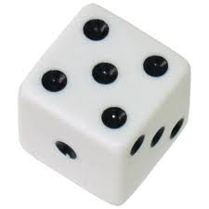
MINI-PLENARY (AfL CARDS)
A
1
What is the probability of getting an odd number when you roll a fair six sided die?
6
B
1
2
C
1
5
D
5
6
Notes:
2
June 2017. Kindly contributed to www.skillsworkshop.org by Chris Greaves.

Slide 3
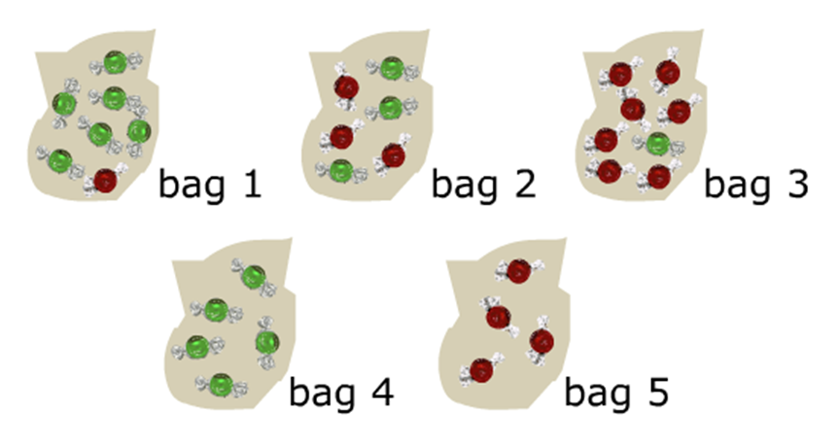
MINI-PLENARY (AfL CARDS)
A
6
7
B
1
7
C
3
6
D
1
Probability of green from bag 1?
8
Notes:
3
June 2017. Kindly contributed to www.skillsworkshop.org by Chris Greaves.

Slide 4
MINI-PLENARY (AfL CARDS)
A
2
1
B
3
3
C
1
2
D
6
Probability of red from bag 2?
3
Notes:
4
June 2017. Kindly contributed to www.skillsworkshop.org by Chris Greaves.

Slide 5
MINI-PLENARY (AfL CARDS)
A
4
1
B
0
C
1
D
1
Probability of green from bag 5?
4
Notes:
5
June 2017. Kindly contributed to www.skillsworkshop.org by Chris Greaves.

Slide 6
MINI-PLENARY (AfL CARDS)
A
Bag 1
B
Bag 2
C
Bag 3
D
Bag 4
Probability of ‘green is 1’ in which bag?
Notes:
6
June 2017. Kindly contributed to www.skillsworkshop.org by Chris Greaves.

Slide 7
MINI-PLENARY (AfL CARDS)
A
Bag 1
B
Bag 2
C
Bag 3
D
Bag 5
Probability of ‘green is 0’ in which bag?
Notes:
7
June 2017. Kindly contributed to www.skillsworkshop.org by Chris Greaves.

Slide 8
MINI-PLENARY (AfL CARDS)
A
1
5
B
1
C
0
D
5
Probability of purple in any bag?
0
Notes:
8
June 2017. Kindly contributed to www.skillsworkshop.org by Chris Greaves.

Slide 9
MINI-PLENARY (AfL CARDS)
A
1
What is the probability of getting a 5 when you roll a fair six sided die?
6
B
5
1
C
1
5
D
5
6
Notes:
9
June 2017. Kindly contributed to www.skillsworkshop.org by Chris Greaves.

