Slide 1
Percentages of amounts
September 2016. Kindly contributed by Samuel Sao, Thurrock Adult Community College, Essex. Search for Samuel on www.skillsworkshop.org
Please refer to the download page for this resource on skillsworkshop for detailed curriculum links and related resources
Functional Mathematics Curriculum links
L1: Understand and use equivalences between common fractions, decimals and percentages
L2: Understand and use equivalences between fractions, decimals and percentages
Notes:
September 2016. Kindly contributed to www.skillsworkshop.org by Samuel Sao.

Slide 2
Percentages of Amounts

Slide 3
Learning Objectives
1
To be able to find 50%, 25%, and 10% of an amount
2
3
To be able to find 75%, 30%, 5% and 15% of an amount
To be able to find percentage increase and decrease
Notes:
September 2016. Kindly contributed to www.skillsworkshop.org by Samuel Sao.

Slide 4
We use 100% to mean ‘everything’ – the total amount.
So, what is 50% ?
To find 50%, halve the amount OR divide the amount by 2.
Task 1:
Work out the following
50% of £68 =
50% of £90 =
50% of £150 =
Notes:
September 2016. Kindly contributed to www.skillsworkshop.org by Samuel Sao.

Slide 5
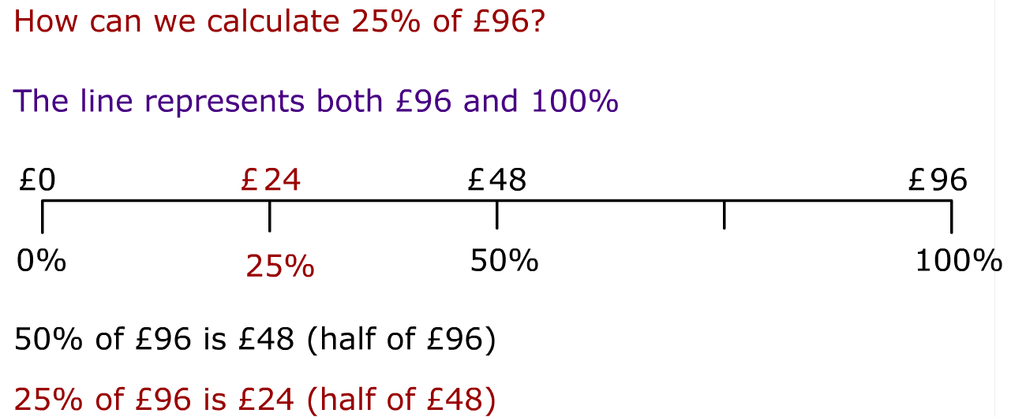
Task 2
Work out the following:
a) 25% of 40cm =
b) 25% of 88kg =
c) 25% of £240 =
Notes:
September 2016. Kindly contributed to www.skillsworkshop.org by Samuel Sao.

Slide 6
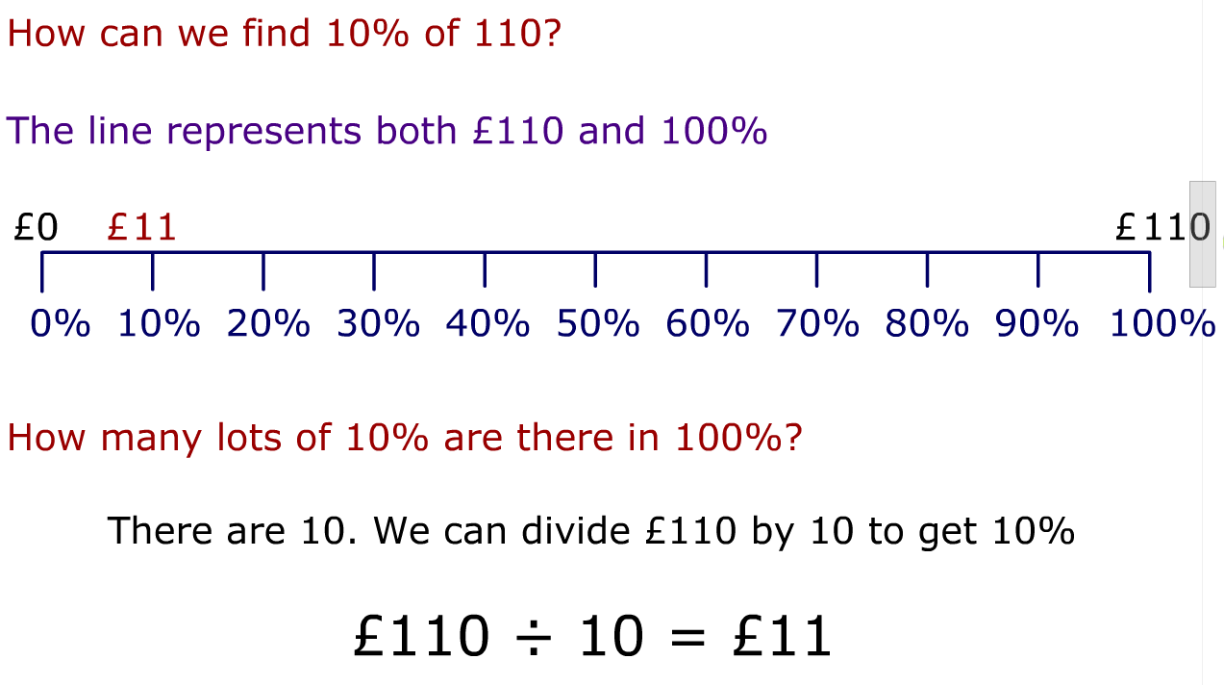
Task 3
Work out the following
a) 10% of £210 =
b) 10% of $415 =
c) 10% of £801 =
Notes:
September 2016. Kindly contributed to www.skillsworkshop.org by Samuel Sao.

Slide 7
Learning Objectives
1
To be able to find 50%, 25%, and 10% of an amount
2
3
To be able to find 75%, 30%, 5% and 15% of an amount
To be able to find percentage increase and decrease
Notes:
September 2016. Kindly contributed to www.skillsworkshop.org by Samuel Sao.

Slide 8
50% of £88 = £44
25% of £88 = £22
75% of £88 = £66
10% of 170 = 17
30% = 3 lots of 10%
= 3 lots of 17 = 3$×17=51$
Challenge
How can we find 15% of £220?
Notes:
September 2016. Kindly contributed to www.skillsworkshop.org by Samuel Sao.

Slide 9
Learning Objectives
1
To be able to find 50%, 25%, and 10% of an amount
2
3
To be able to find 75%, 30%, 5% and 15% of an amount
To be able to find percentage increase and decrease
Notes:
September 2016. Kindly contributed to www.skillsworkshop.org by Samuel Sao.

Slide 10
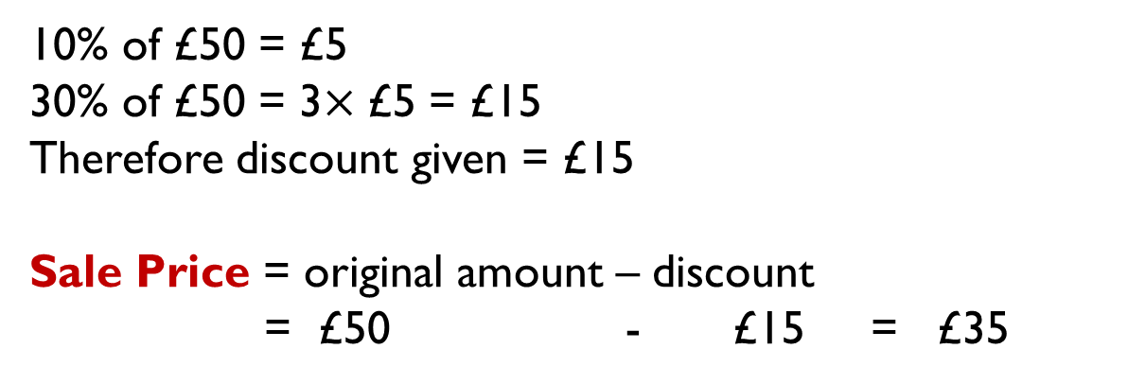
A pair of jeans is in a sale. The sale offers a discount of 30%. The jeans originally cost £50.
What was the price of the jeans in the sale?
10% of £50 = £5
30% of £50 = 3$×\text{£5}$ = £15
Therefore discount given = £15
Sale Price = original amount – discount
= £50 - £15 = £35
Task 4
Work out the new prices after the percentage discount has been made
Item | Original price | Discount % | New Price
Iphone 6 | £600 | 20%
Samsung S4 | £500 | 10%
Sony Experia Z4 | £500 | 5%
Notes:
September 2016. Kindly contributed to www.skillsworkshop.org by Samuel Sao.

Slide 11
Asda has INCREASED its sales by 20% this year. It sold 2400 items last year.
How many items has it sold this year?
10% of 2400 = 240
20% of 2400 = 2 $×240=480$
Total items sold this year = items sold last year + increase
= 2400 + 480
= 2880
Task 5
Notes:
September 2016. Kindly contributed to www.skillsworkshop.org by Samuel Sao.

