Slide 1
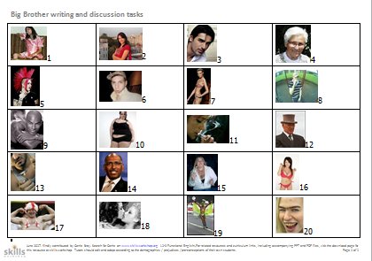
Big Brother Functional English - discussion and writing skills
This PPT and 20 accompanying images (in a separate Word file) are add-ons to the original Big Brother discussion task (Carrie Bray, Skillsworkshop, 2011).
June 2017. Kindly contributed by Carrie Bray. Search for Carrie on www.skillsworkshop.org and visit the download page for this resource to find further links and related resources.
Covers many aspects of L1-2 Functional English (writing, reading, discussion).
Notes:
June 2017. Kindly contributed to www.skillsworkshop.org by Carrie Bray

Slide 2
Warm Up
Which TV shows do you enjoy watching?
Are there any that make you switch the TV off?
Notes:
June 2017. Kindly contributed to www.skillsworkshop.org by Carrie Bray

Slide 3
What About This?
Notes:
June 2017. Kindly contributed to www.skillsworkshop.org by Carrie Bray

Slide 4
Today you will:
Take part in a discussion
Speak clearly
Use appropriate language
Challenge preconceptions and prejudices
Use punctuation and capital letters
Plan & draft writing
Produce a neat version
Notes:
June 2017. Kindly contributed to www.skillsworkshop.org by Carrie Bray

Slide 5
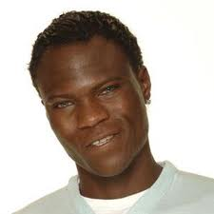
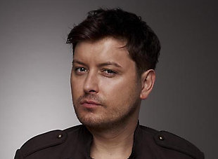
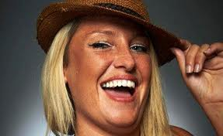
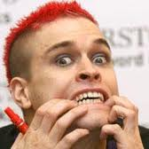
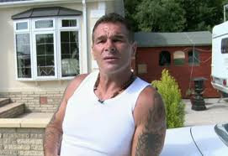
Previous Winners:
Notes:
June 2017. Kindly contributed to www.skillsworkshop.org by Carrie Bray

