Slide 1
TATTOO SPELLING
December 2011.
Kindly contributed by Carrie Bray. Search for Carrie on www.skillsworkshop.org and visit the download page for this resource to find further links and related resources
Curriculum links
This PPT is useful for underpinning the spelling elements of the Entry 3 and Level 1 Functional English criteria and the Adult Literacy Curriculum. Please refer to the resource description page on skillsworkshop for detailed curriculum links and related resources.
Notes:
October 2011. Kindly contributed to www.skillsworkshop.org by Judith White, Somerset Skills & Learning

Slide 2
Ever wanted a tattoo?
This is why literacy matters...

Slide 3
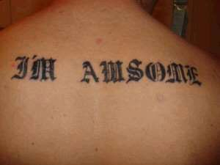
Correct the mistake:

Slide 4
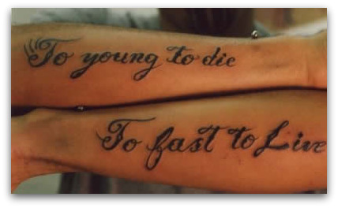
Correct the mistake:

Slide 5
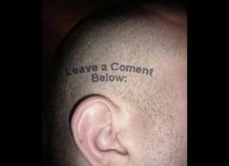
Correct the mistake:

Slide 6
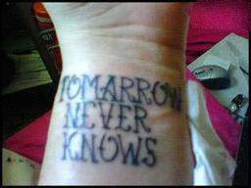
Correct the mistake:

Slide 7
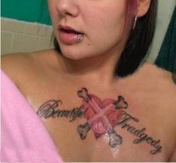
Correct the mistake:

Slide 8
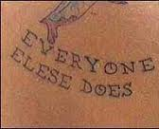
Correct the mistake:

Slide 9
Correct the mistake:

Slide 10
Correct the mistake:

Slide 11
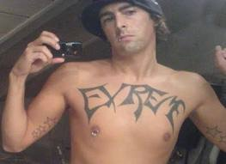
Correct the mistake:

Slide 12
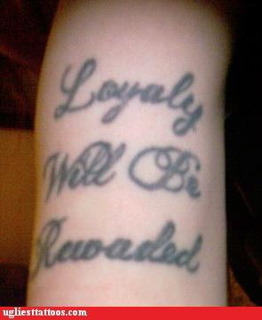
Correct the mistakes:

