Slide 1
Formal and informal language
February 2012.
Kindly contributed by Emily Nichols, Sheffield.
Search for Emily on www.skillsworkshop.org and visit the download page for this resource to find further links and related resources.
This PPT accompanies a separate word match game and printed versions of the letter on slide 5.
Curriculum links
Covers E3-L2 Functional English.
E3 Write texts with some adaptation to the intended audience
L1Use language, format and structure suitable for purpose and audience
L2 Use a range of writing styles for different purposes
Also covers many adult literacy elements inc.
Wt/L1.4 Use language suitable for purpose and audience.
Wt/L2.5 Use formal and informal language appropriate to purpose and audience
Notes:
Feb 2012. Kindly contributed to www.skillsworkshop.org by Emily Nichols, Sheffield
UK Adult Literacy Links: Wt/L1.4 Use language suitable for purpose and audience. Wt/L2.5 Use formal and informal language appropriate to purpose and audience
Functional English
E3 Write texts with some adaptation to the intended audience
L1 Use language, format and structure suitable for purpose and audience
L2 Use a range of writing styles for different purposes

Slide 2
Formal and Informal language
Recognising the differences
Notes:
Feb 2012. Kindly contributed to www.skillsworkshop.org by Emily Nichols, Sheffield
UK Adult Literacy Links: Wt/L1.4 Use language suitable for purpose and audience. Wt/L2.5 Use formal and informal language appropriate to purpose and audience
Functional English
E3 Write texts with some adaptation to the intended audience
L1 Use language, format and structure suitable for purpose and audience
L2 Use a range of writing styles for different purposes

Slide 3
In which situations do you use more formal language?
Job interviews
Job Application Forms and CV’s
At work
In a Court of Law
Business transactions
Contact with the local council
Complaints
Contact with the police
On the phone
Notes:
Feb 2012. Kindly contributed to www.skillsworkshop.org by Emily Nichols, Sheffield
UK Adult Literacy Links: Wt/L1.4 Use language suitable for purpose and audience. Wt/L2.5 Use formal and informal language appropriate to purpose and audience
Functional English
E3 Write texts with some adaptation to the intended audience
L1 Use language, format and structure suitable for purpose and audience
L2 Use a range of writing styles for different purposes

Slide 4
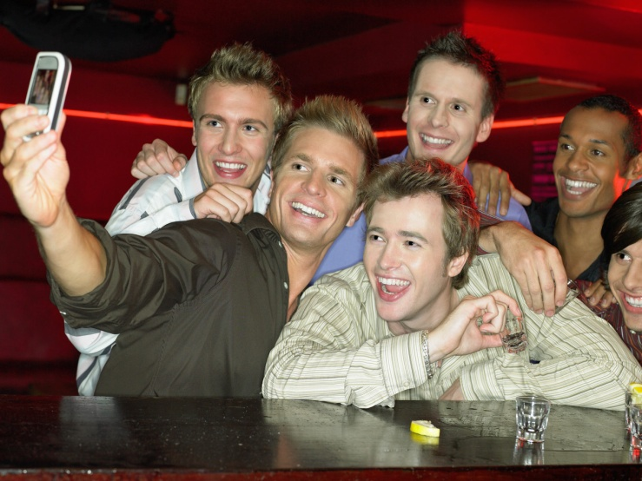
What language would you use in these
situations and why?
Notes:
Feb 2012. Kindly contributed to www.skillsworkshop.org by Emily Nichols, Sheffield
UK Adult Literacy Links: Wt/L1.4 Use language suitable for purpose and audience. Wt/L2.5 Use formal and informal language appropriate to purpose and audience
Functional English
E3 Write texts with some adaptation to the intended audience
L1 Use language, format and structure suitable for purpose and audience
L2 Use a range of writing styles for different purposes

Slide 5
Write the purpose for writing in your first sentence. For example -I am writing to inform/ I am writing to enquire....
Dear Sir/ Madam is more formal
The short form is informal- use I have
Hi,
Heard about the job, reckon I would be great at it! I’ve done that kind of work before, working in my local and fink pub work is buzzing. They even trusted me with the readies, like. I was a cleaner before that, but that was gross and I don’t wanna do that again! Give us a chance, ring me on 01709 245 6789.
Cheers!
Sam
think
Sign off more formally using Yours faithfully or Yours sincerely
Want to
Instead of give us a chance, sign off with Thank you for taking the time to read my letter.
! Is more informal and looks as if you are shouting
Put your full name including your surname
Too negative for a cover letter, think how the skills could be transferred
Notes:
Feb 2012. Kindly contributed to www.skillsworkshop.org by Emily Nichols, Sheffield
UK Adult Literacy Links: Wt/L1.4 Use language suitable for purpose and audience. Wt/L2.5 Use formal and informal language appropriate to purpose and audience
Functional English
E3 Write texts with some adaptation to the intended audience
L1 Use language, format and structure suitable for purpose and audience
L2 Use a range of writing styles for different purposes

Slide 6
Lets make it more formal!
I am writing to ask........
I am writing to enquire....
Let you know.....
Inform....
Ask for.....
Request......
Bye....
Yours Faithfully/ Yours Sincerely....
Notes:
Feb 2012. Kindly contributed to www.skillsworkshop.org by Emily Nichols, Sheffield
UK Adult Literacy Links: Wt/L1.4 Use language suitable for purpose and audience. Wt/L2.5 Use formal and informal language appropriate to purpose and audience
Functional English
E3 Write texts with some adaptation to the intended audience
L1 Use language, format and structure suitable for purpose and audience
L2 Use a range of writing styles for different purposes

