Slide 1

St George’s Day
April 2011. Kindly contributed by Mark Sergison, Dudley College.
Search for Mark on www.skillsworkshop.org
This PPT was originally written for a 1 hour revision class.
Alternative versions for 1.5 hr and 2.5hr lessons (that also cover L2 area of circles, triangles, etc.) are also available on skillsworkshop.
Curriculum links
Covers aspects of Level 1 Functional Mathematics and adult numeracy including decimals, multiplication, and area of rectangles. Please refer to the download page for this resource on skillsworkshop.org for detailed curriculum links and related resources.
The PPT includes mentions of other external sites / resources such as BBC Skillswise, BKSB and BBC Bitesize. Direct links are not provided so the tutor should read through and research these (or edit to include their own worksheets, etc.) before using this PPT.
Notes:
April 2011. Kindly contributed to www.skillsworkshop.org by Mark Sergison, Dudley College.

Slide 2

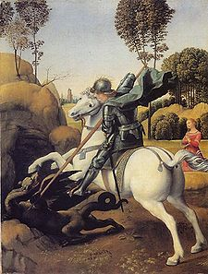
St. George’s Day
Notes:
April 2011. Kindly contributed to www.skillsworkshop.org by Mark Sergison, Dudley College.

Slide 3

Lesson Objective
Calculate the area of rectangles
Lesson Outcomes
Correctly match at least 5 rectangles with whole numbers to the correct area (all).
Correctly measure at least 5 rectangles to the nearest 0.5cm & calculate their areas (most).
Achieve at least 70% on a quiz on calculating the area of rectangles (some)

Slide 4
Area of Rectangles
Underpinning skill = multiply pairs of numbers, particularly decimals:
2.8 x 46 =
3.1 x 4.9 =
6.12 x 7.3 =
128.8
15.19
44.676

Slide 5
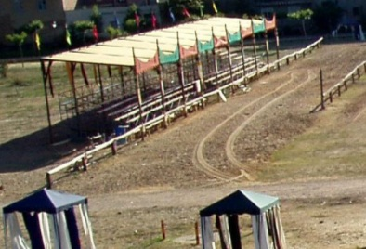
Applying this skill
The shape of the jousting field is rectangular. It measures 9.8m wide and 22.5m long. What is its area?
220.5m²

Slide 6
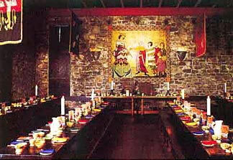
Applying this skill
The rectangular banquet hall needs new floor wood panels. It measures 28m long and 9.42m wide. What is it’s area?
263.76m²

Slide 7
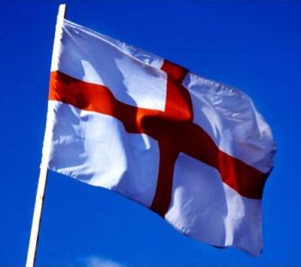
Developing the skill.
St. George wants a flag made so he can wave it after slaying the dragon. He wants it to be 2.3m long and 80cm high. What will its area be?
1.84m² OR 18,400cm²

Slide 8
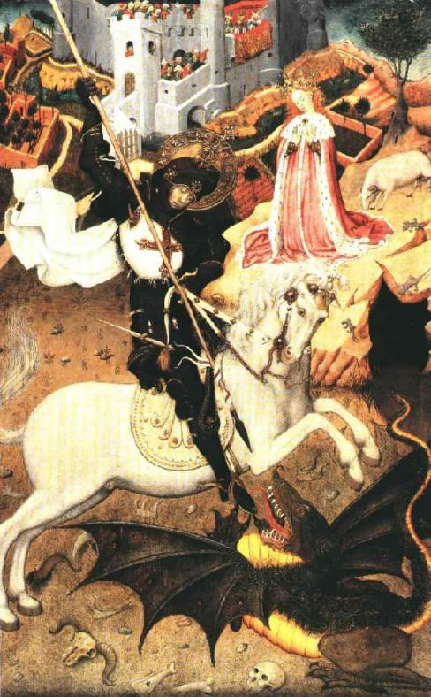
Developing the skill.
A piece of fabric is needed to depict the story of St. George and the dragon. It is 45cm long and 380mm wide. What will its area be?
1710cm²
OR
171,000mm²

Slide 9
Independent activity
Confident?
Try Skillswise worksheet 1
      OR
Need a bit more Practice?
Try bksb Exercise 2 sheet
Computer Activity
Skillswise Area of Rectangles quizzes.
Make a note of your scores on your lesson session sheet.

Slide 10
Extension
St. George wants a rectangular section of ground prepared for swordsmanship training:
He wants the area of the space to be 60m².
What could the dimensions of the training ground be?

